Slide 1



Rack Mount Wood Board
MEMSDuino
Lafe Spietz
NIST
2024

Slide 2
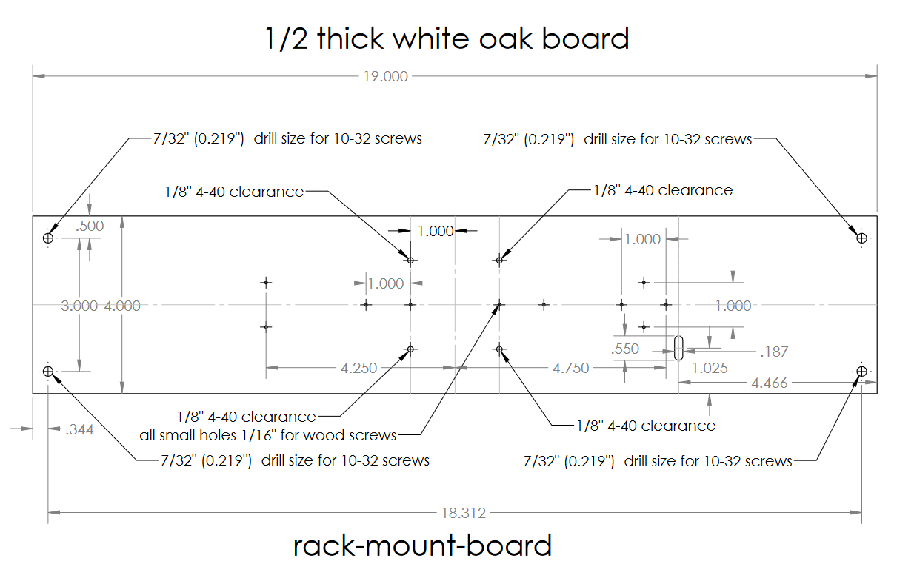

Slide 3
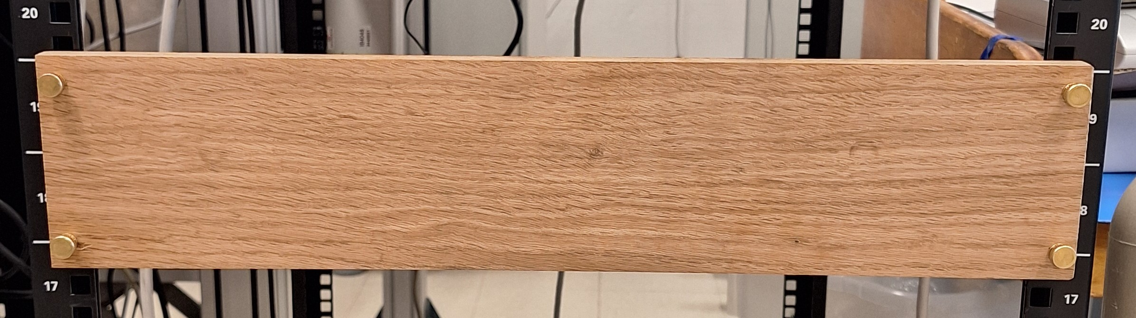
Slightly more than 2U Blank Rack Panel

Slide 4
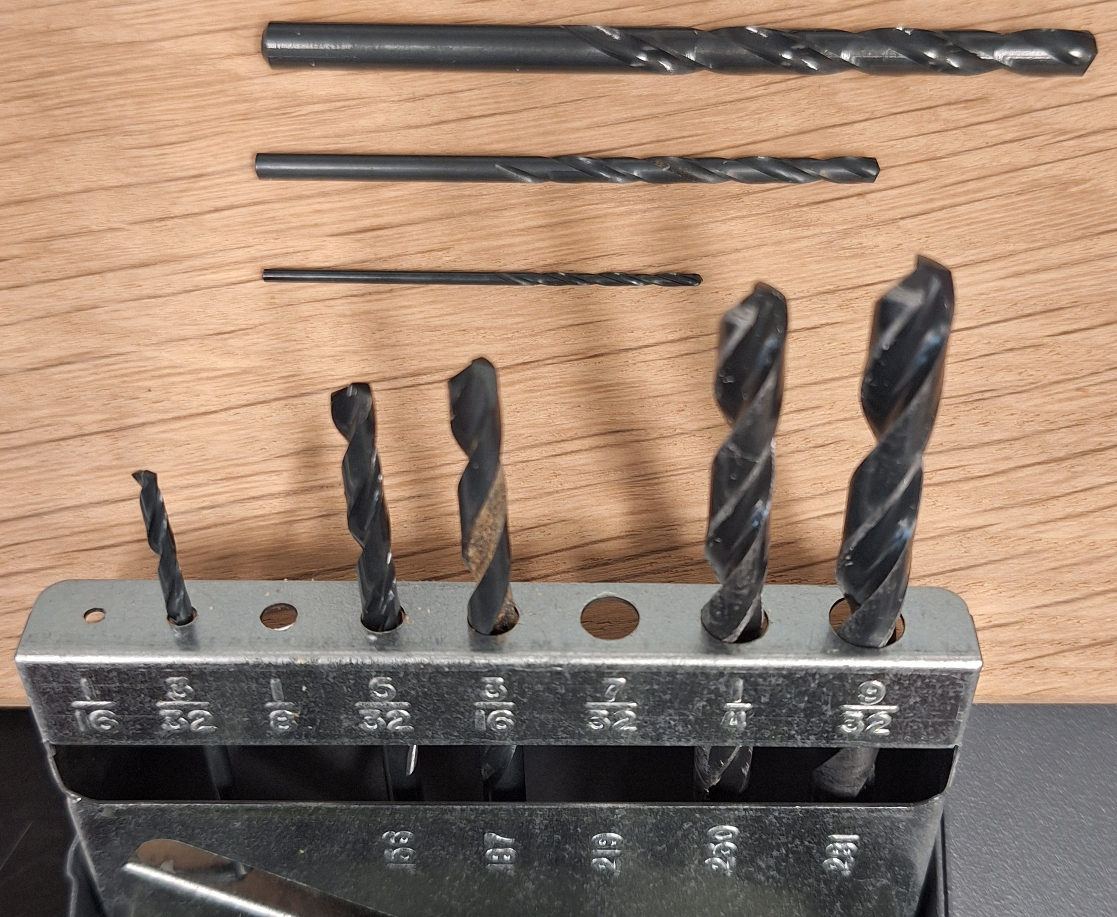
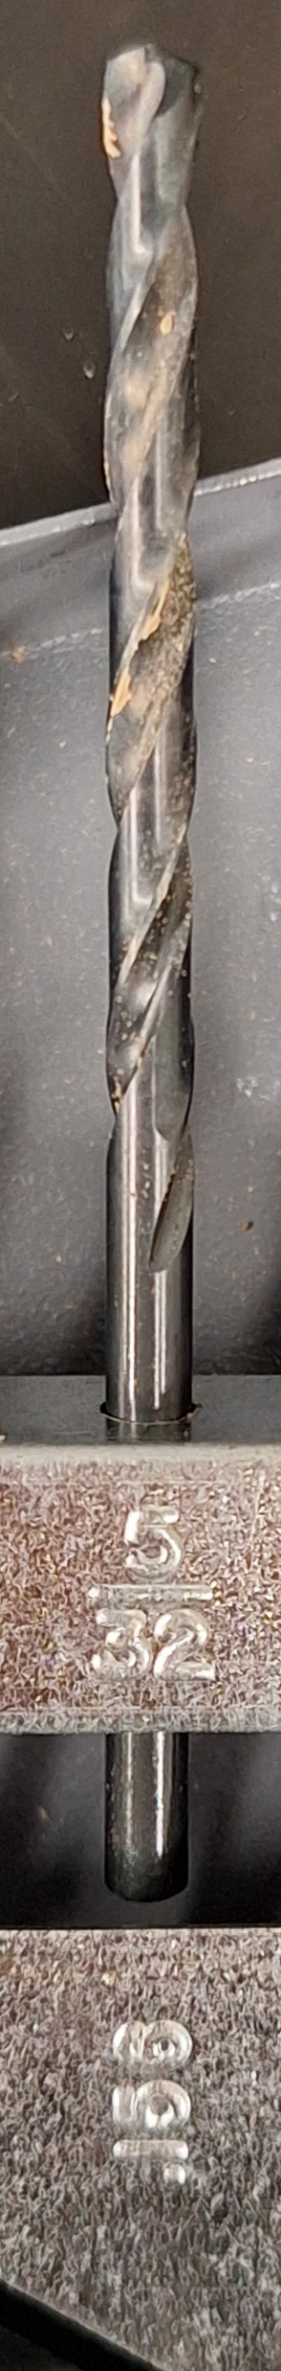
Drill bits to use
1/16” bit: pilot holes and holes for wood screws.
1/8” bit: through holes for 4-40 screws
7/32” for 10-32 thumb screw clearance holes
5/32” to mill out slot for 4 wire header cable

Slide 5
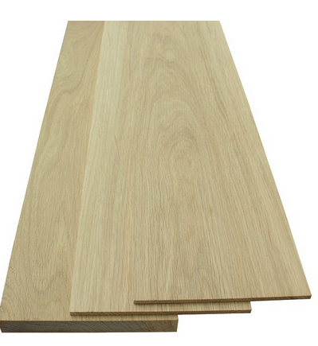
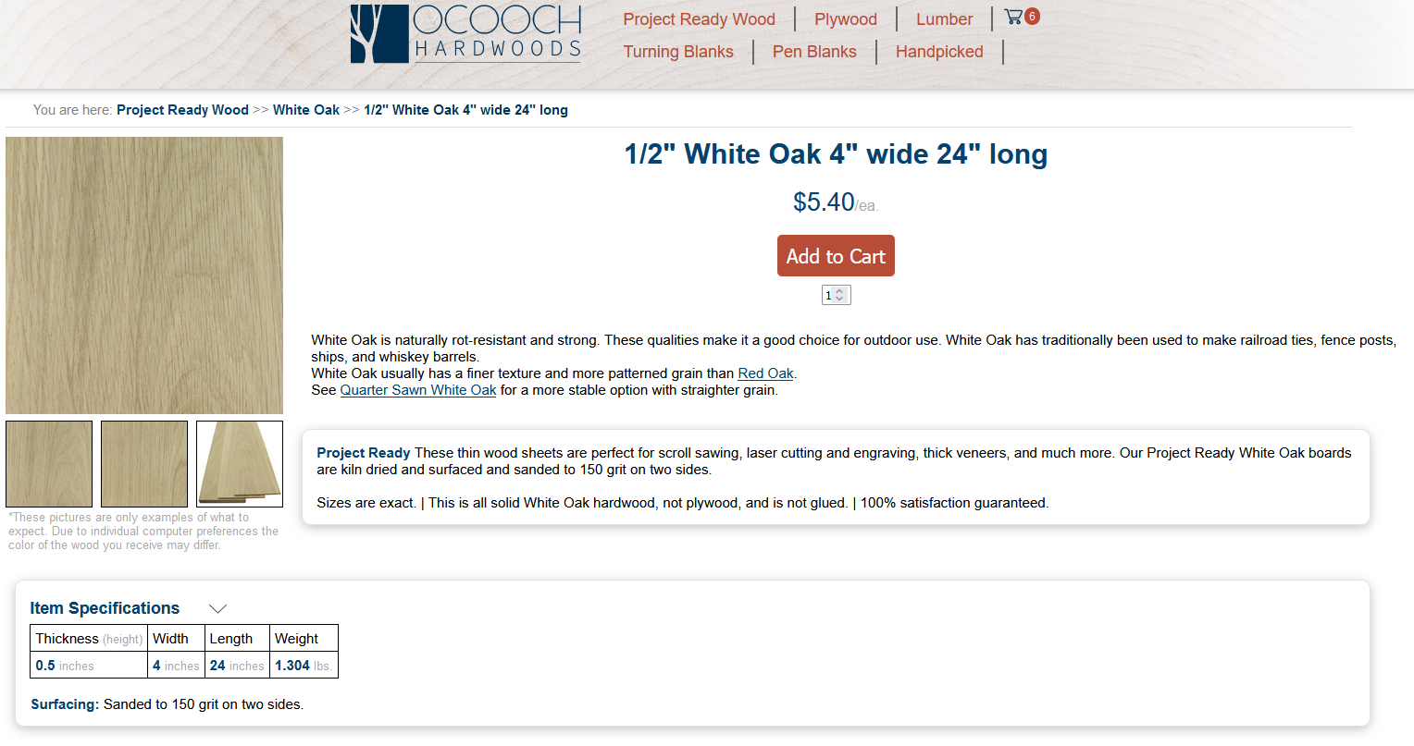
4”x24”x0.5” White Oak Boards
https://ocoochhardwoods.com/detail/?i=124wo

Slide 6
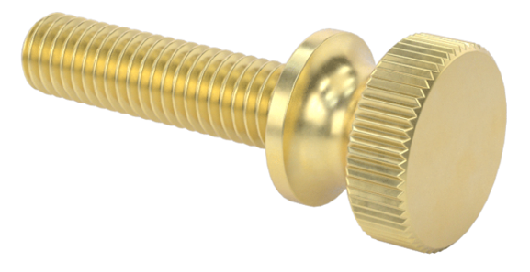
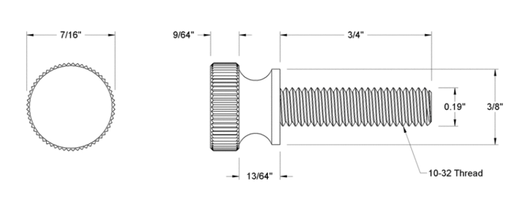
Knurled Brass Thumb Screws to Mount in Panel
https://www.mcmaster.com/92421A645/

Slide 7

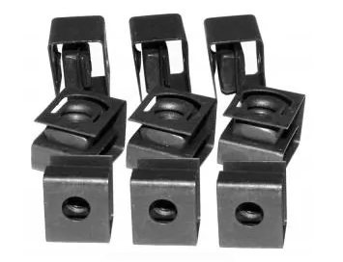
Rack Mount Nuts
https://www.mouser.com/ProductDetail/Hammond-Manufacturing/1421NP25?qs=yc9RBI4tIALvGirsWAVfbg%3D%3D

Slide 8
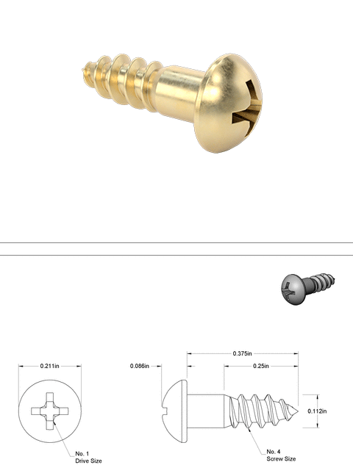
Wood screws
https://www.mcmaster.com/98685A540/

Slide 9
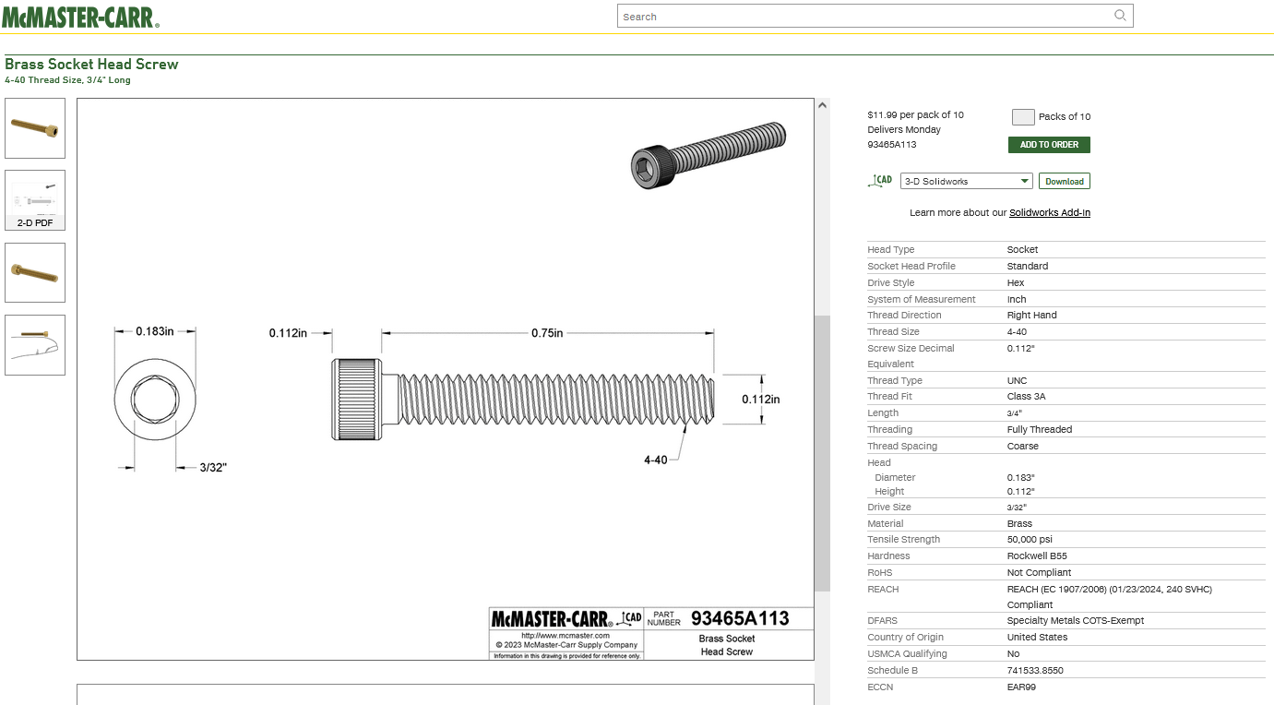
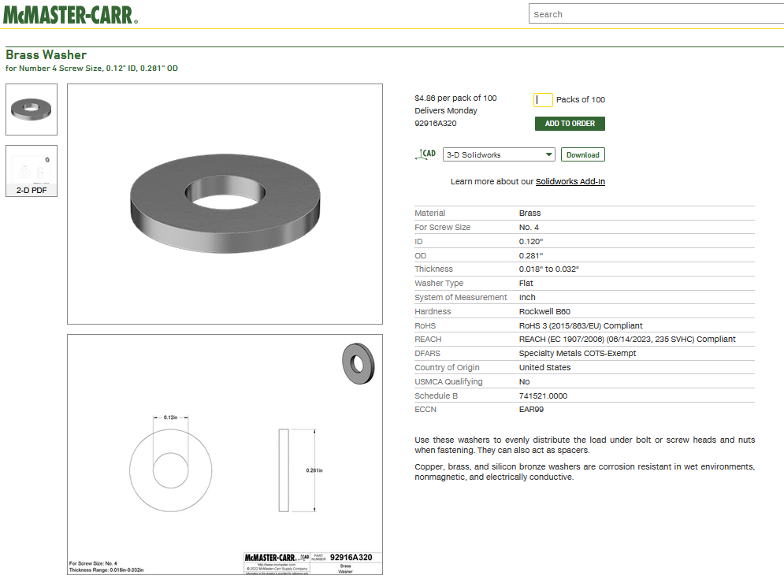
4-40 Brass screws and washers
https://www.mcmaster.com/93465A113/
https://www.mcmaster.com/92916A320/

Slide 10
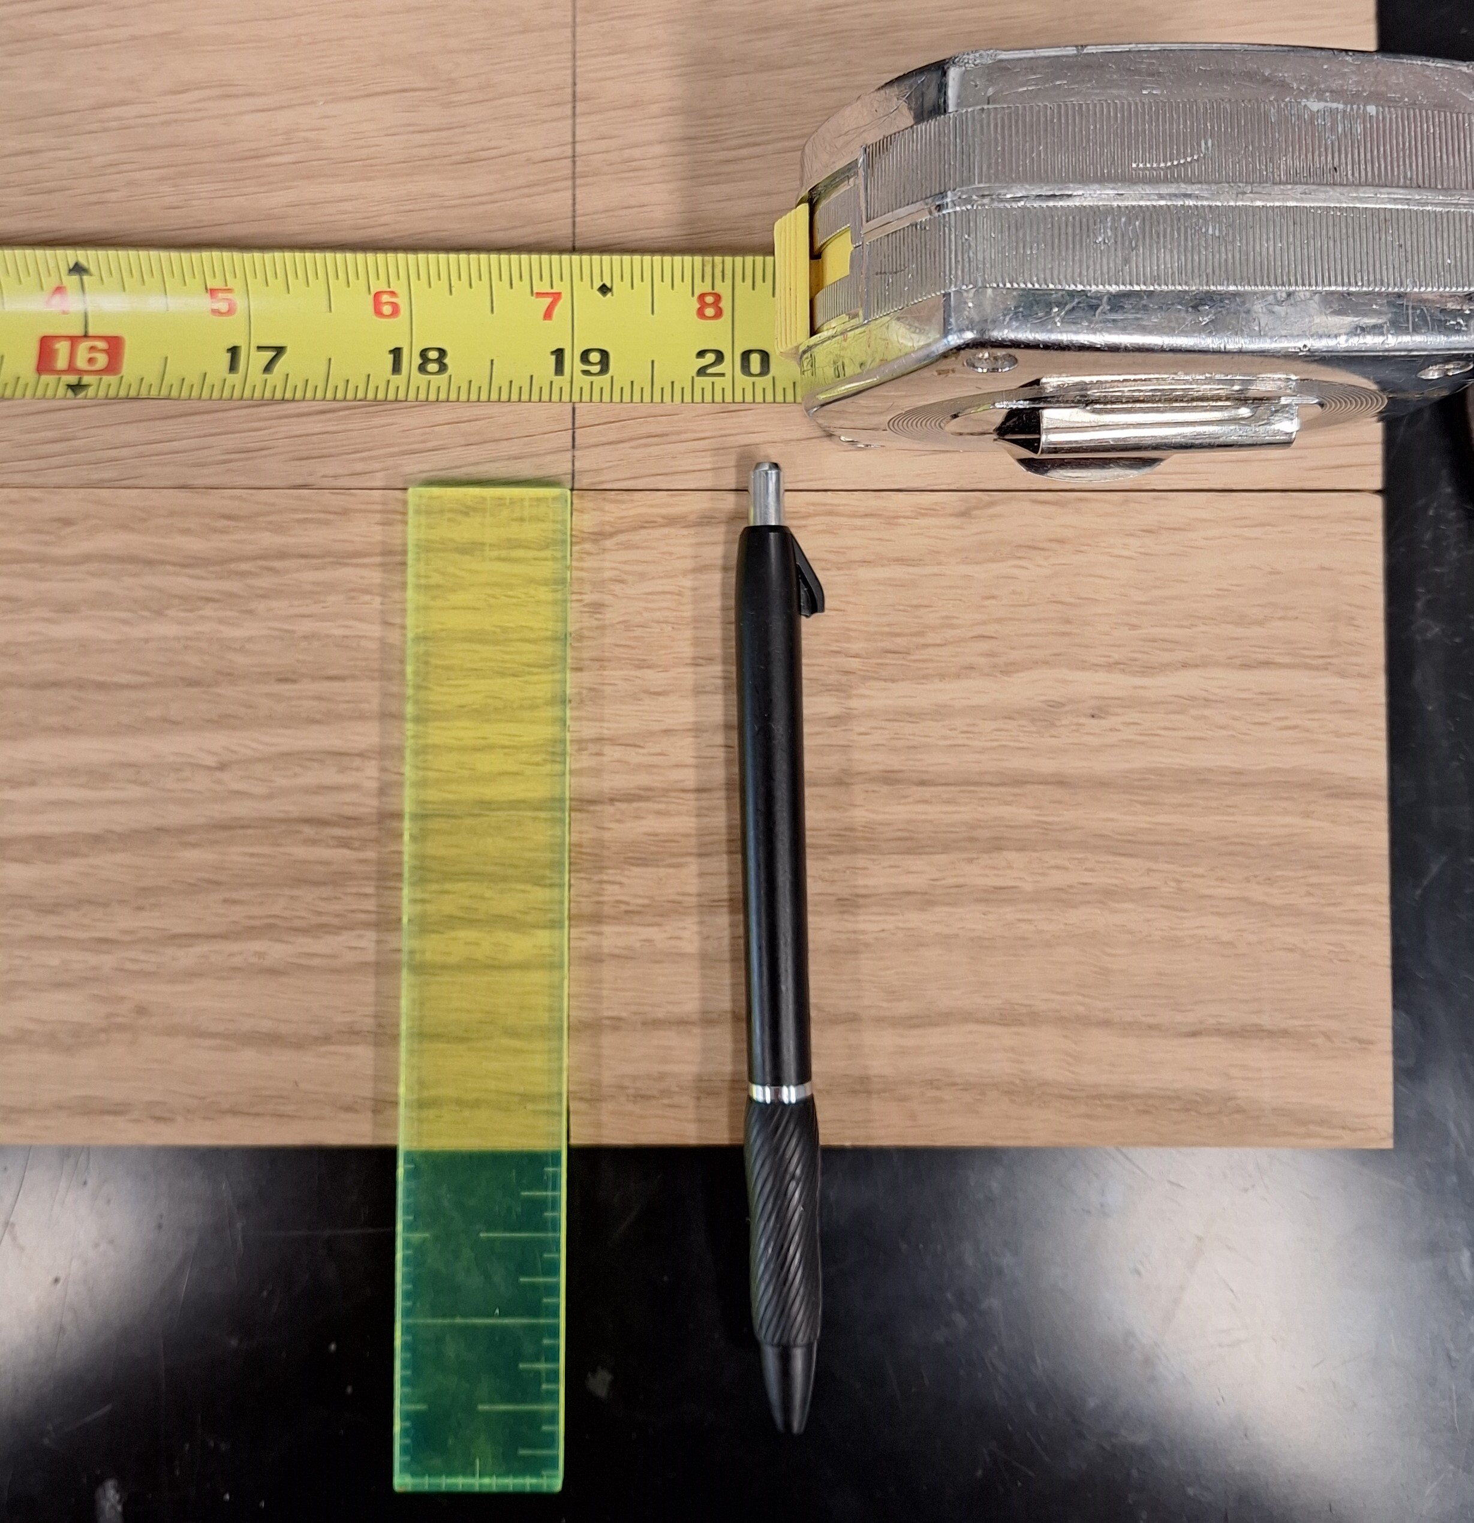
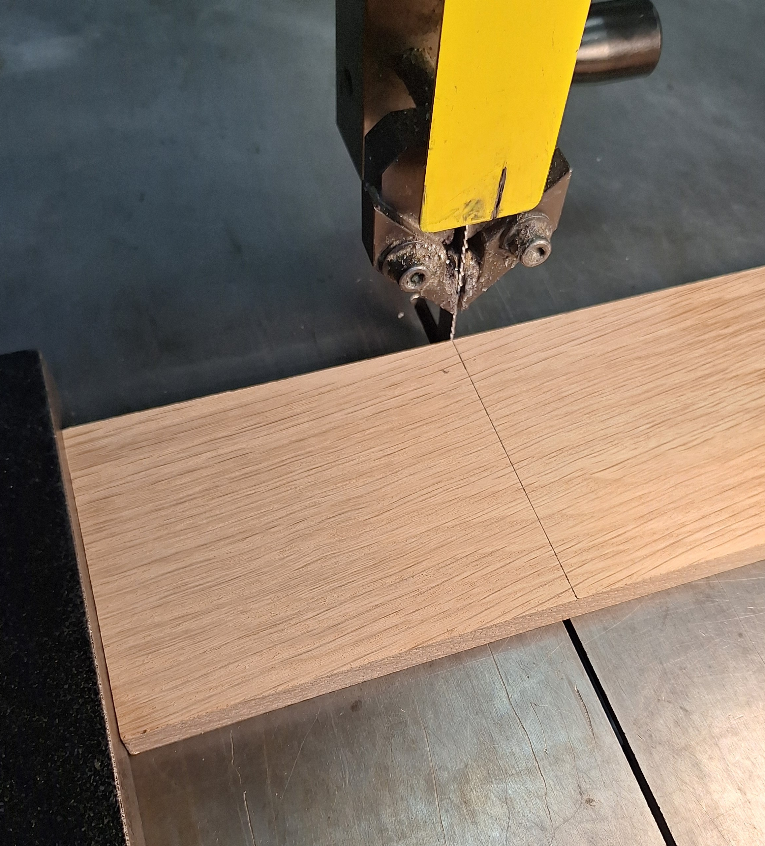
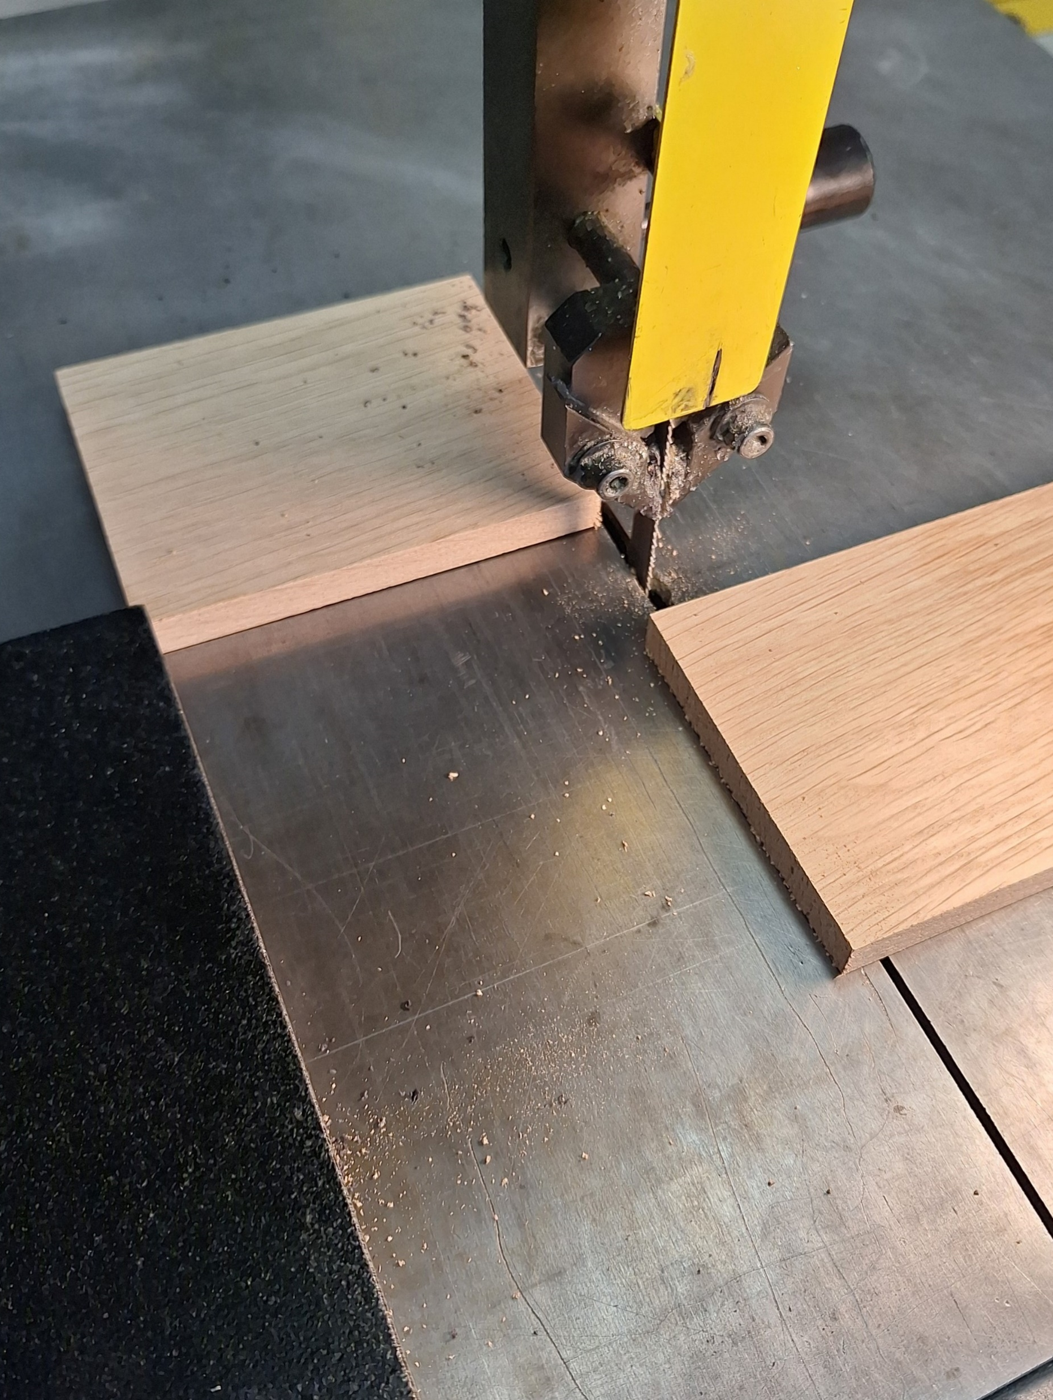
Cut board off at 19 inches

Slide 11
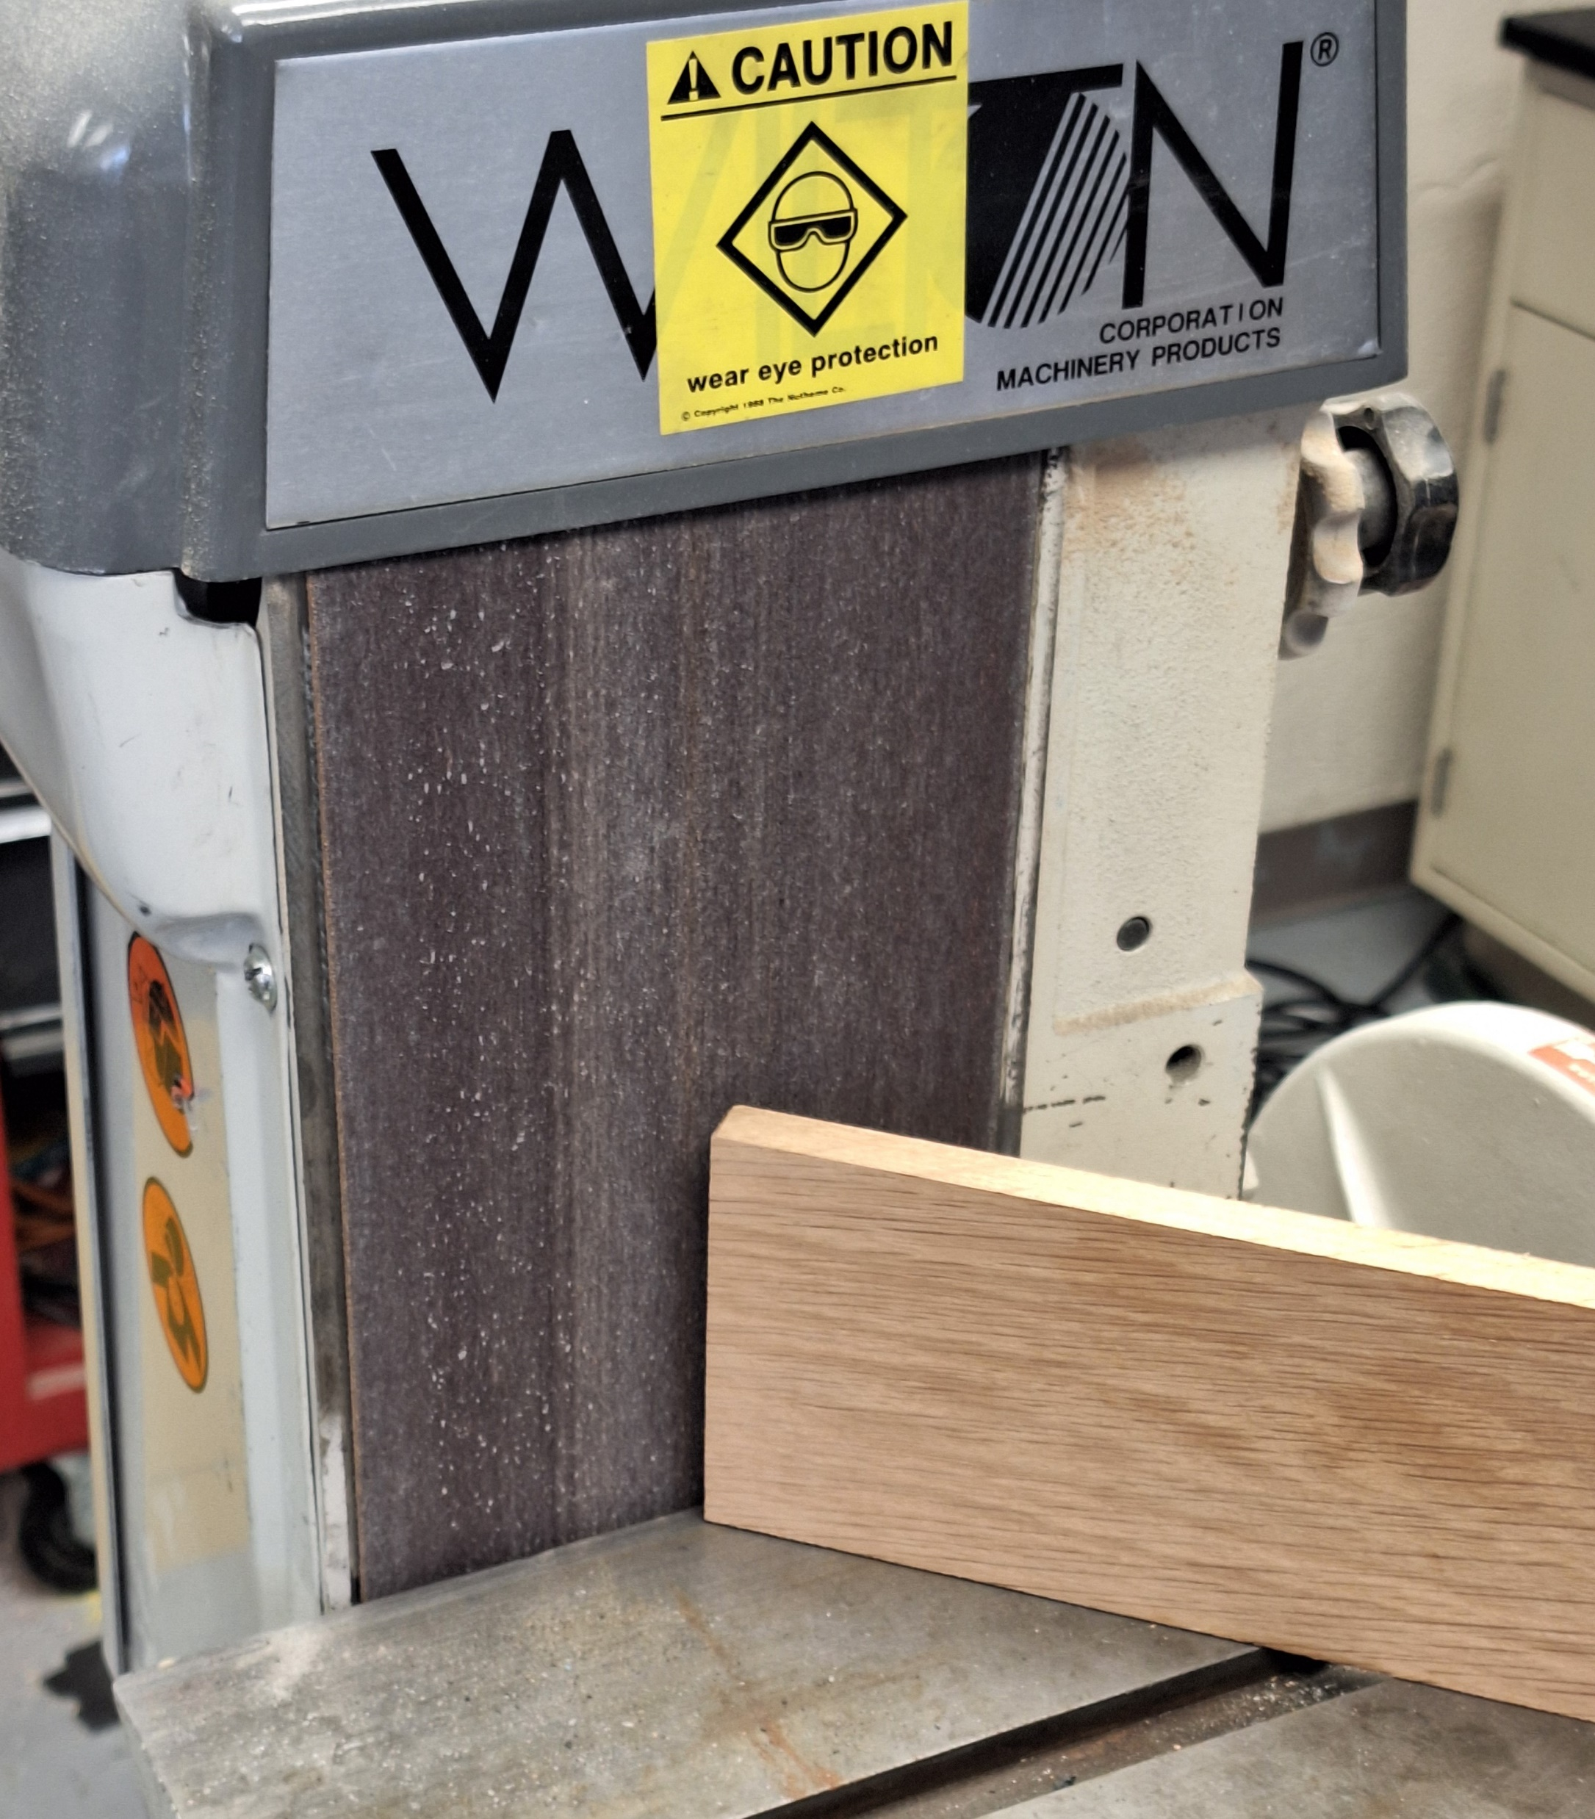
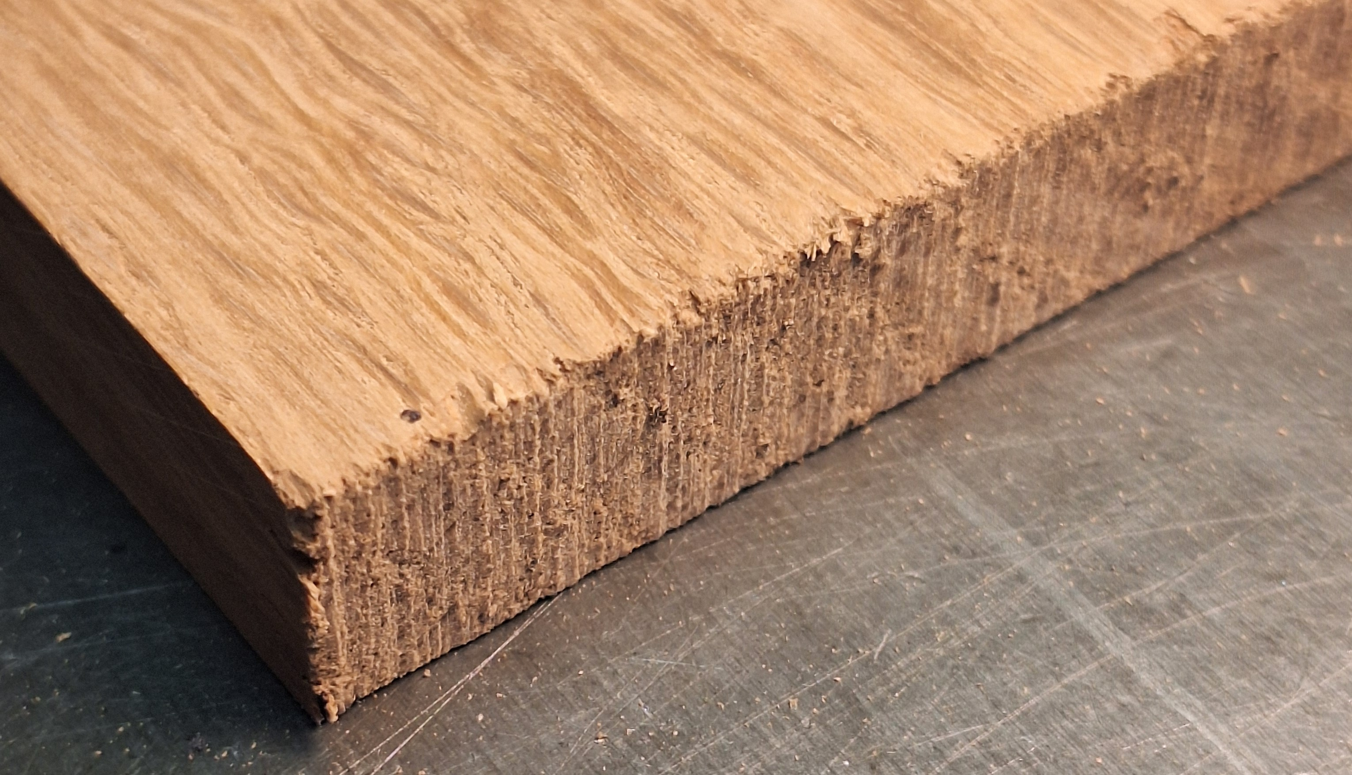
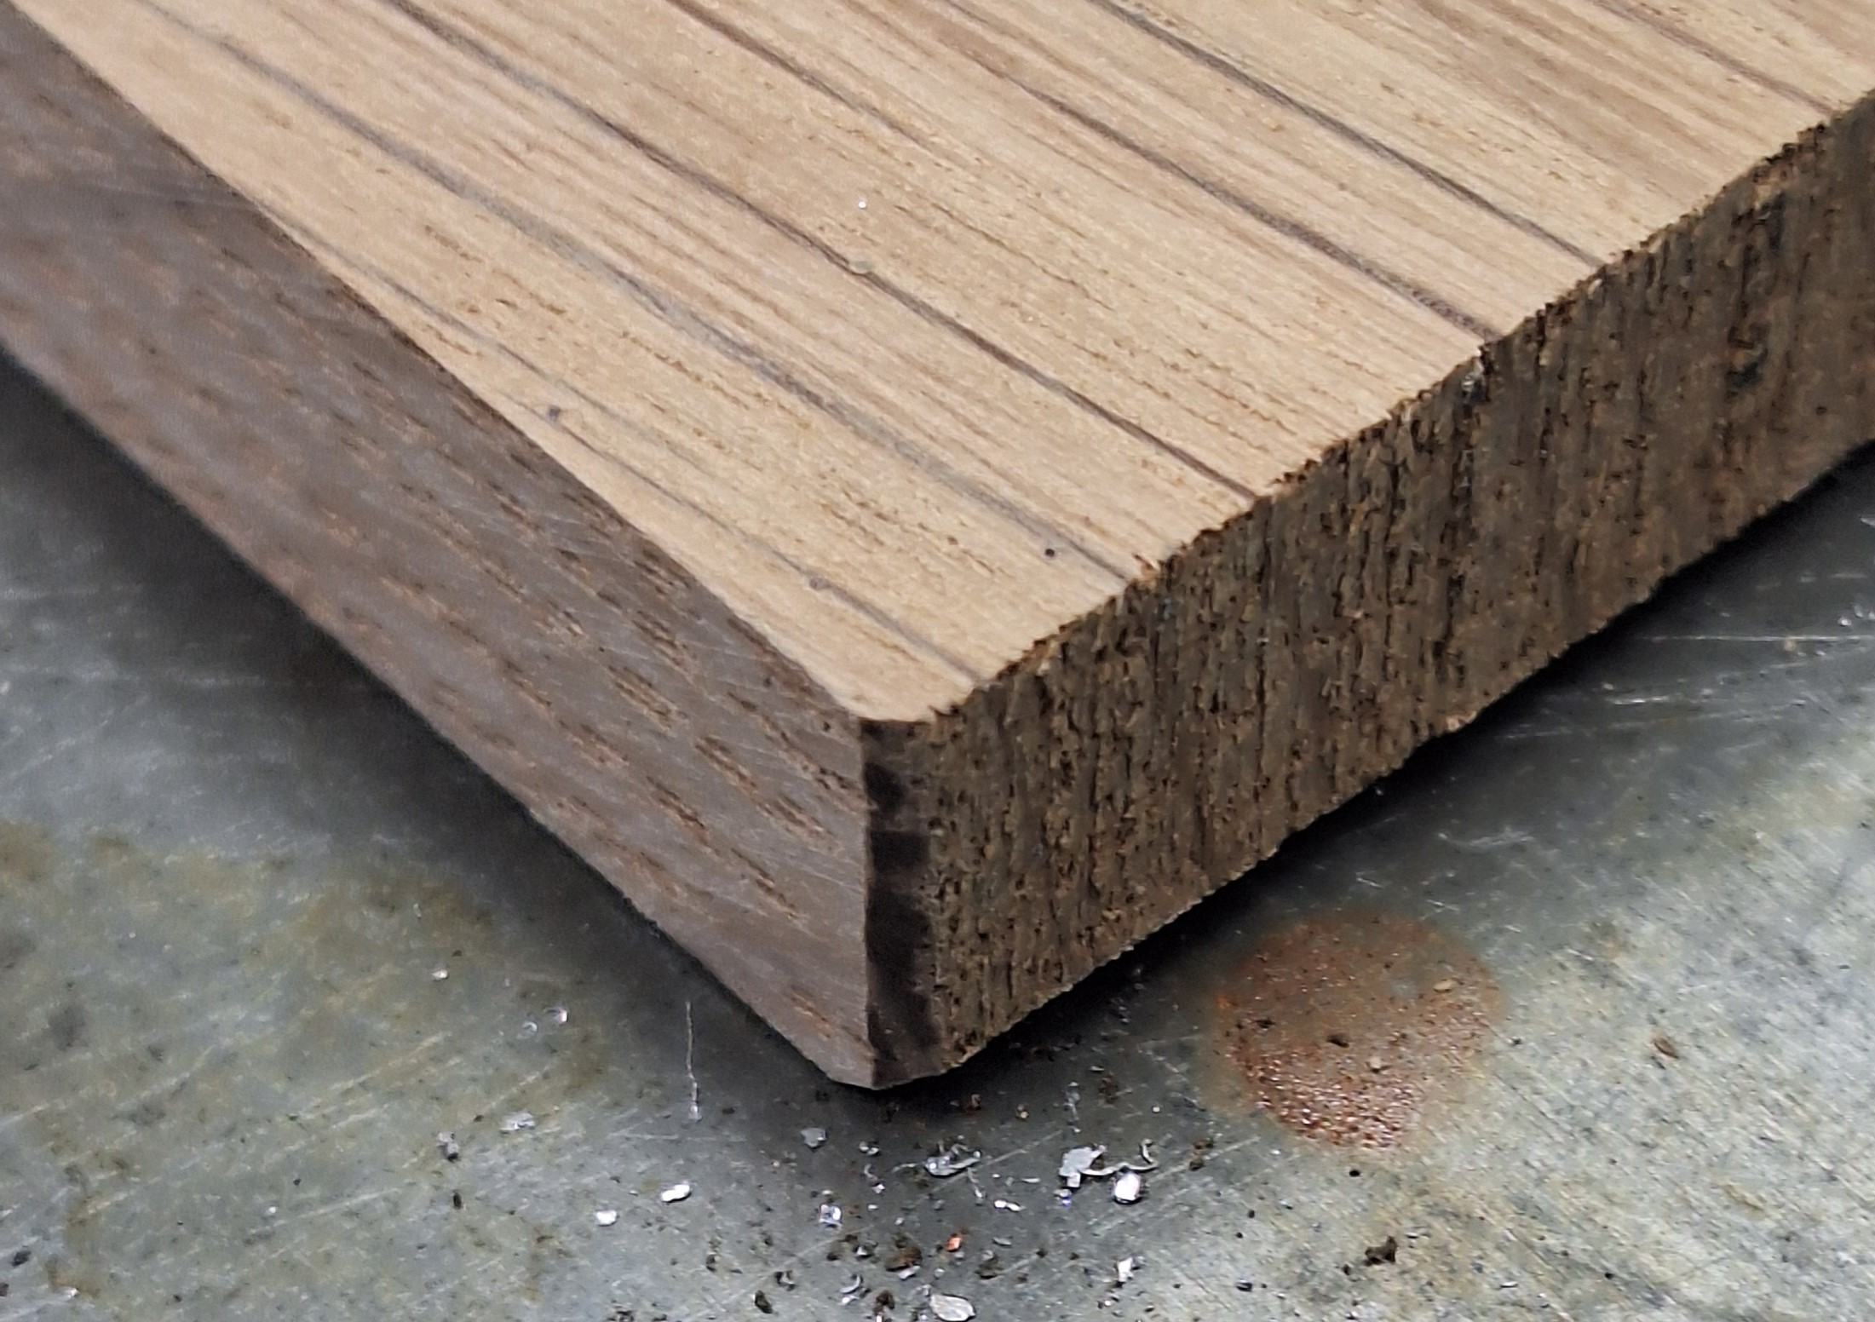
Sand or file edges

Slide 12
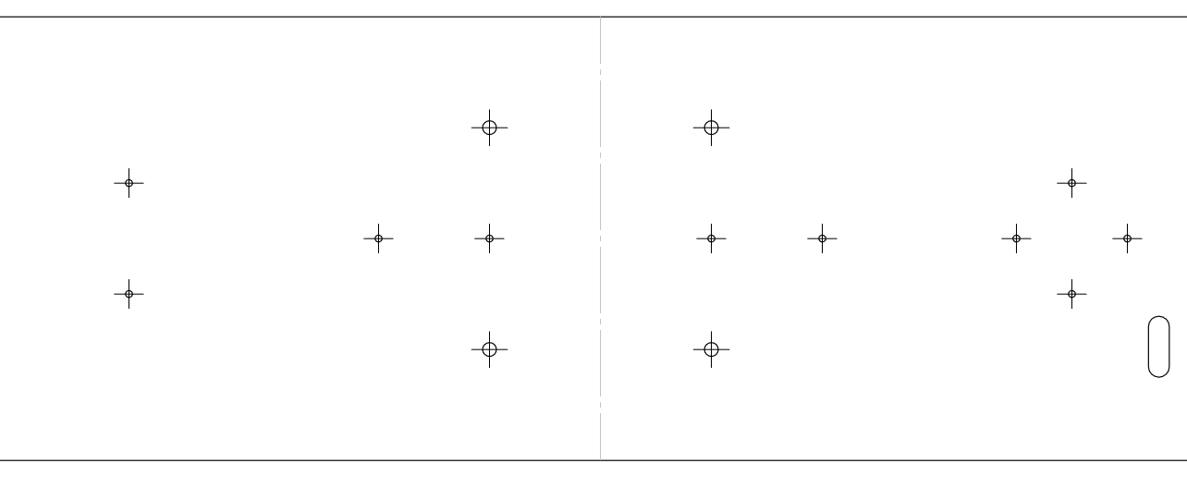
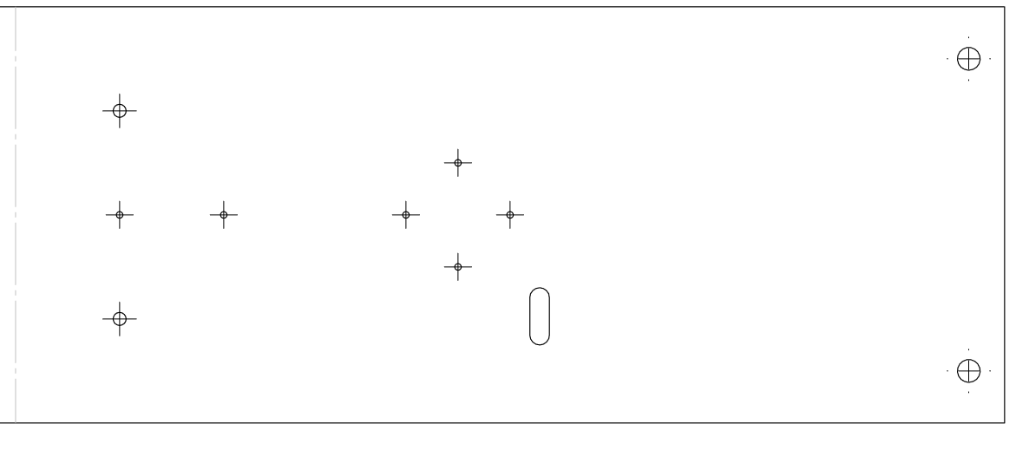
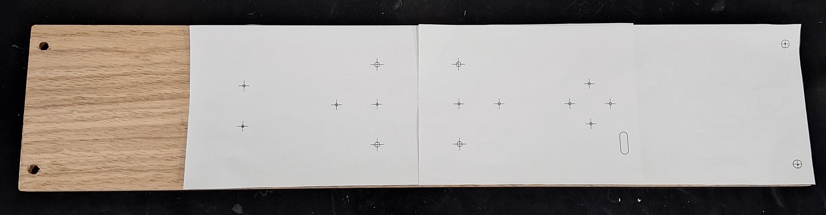
Print Templates And use for Hole Punches

Slide 13
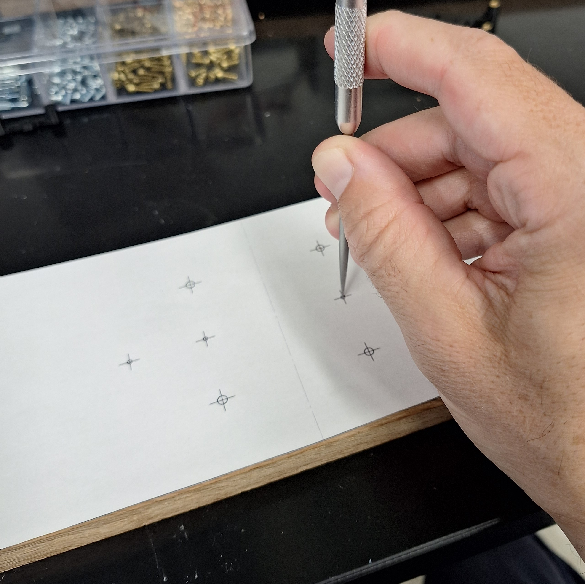
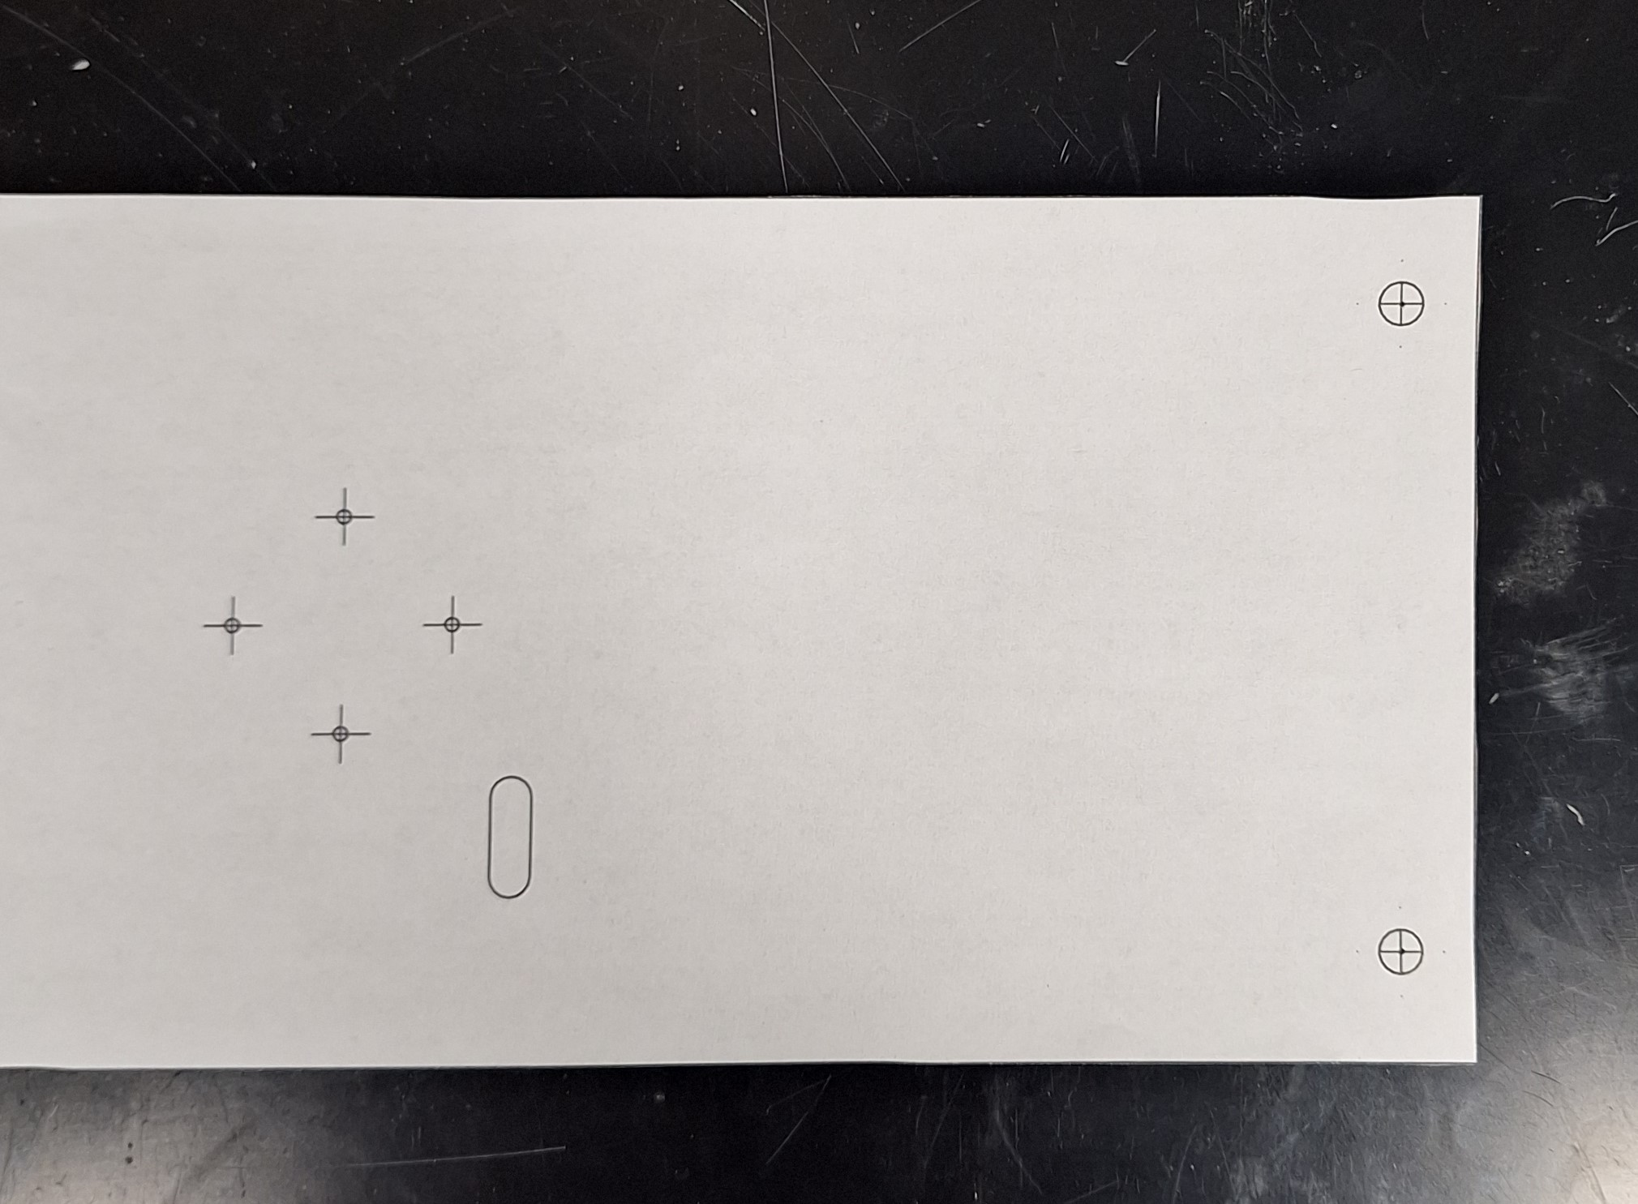
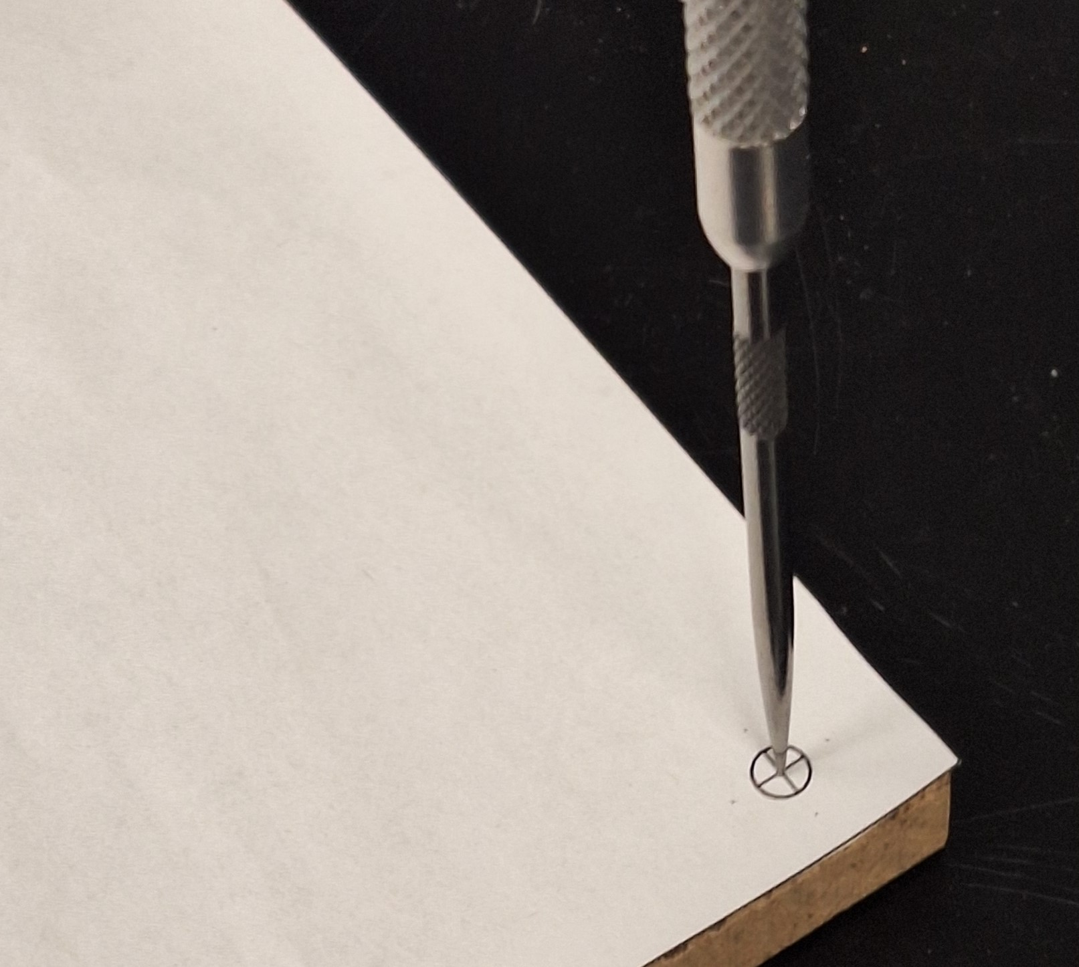
Punch hole locations with sharp object

Slide 14
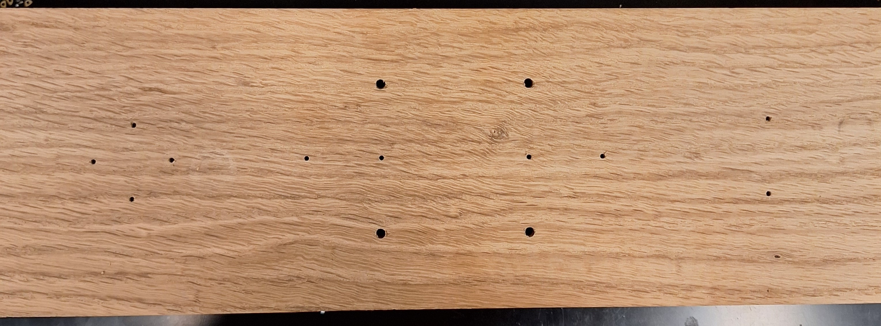
Drill pattern in center of board
1/8”
1/16”
1/16”

Slide 15
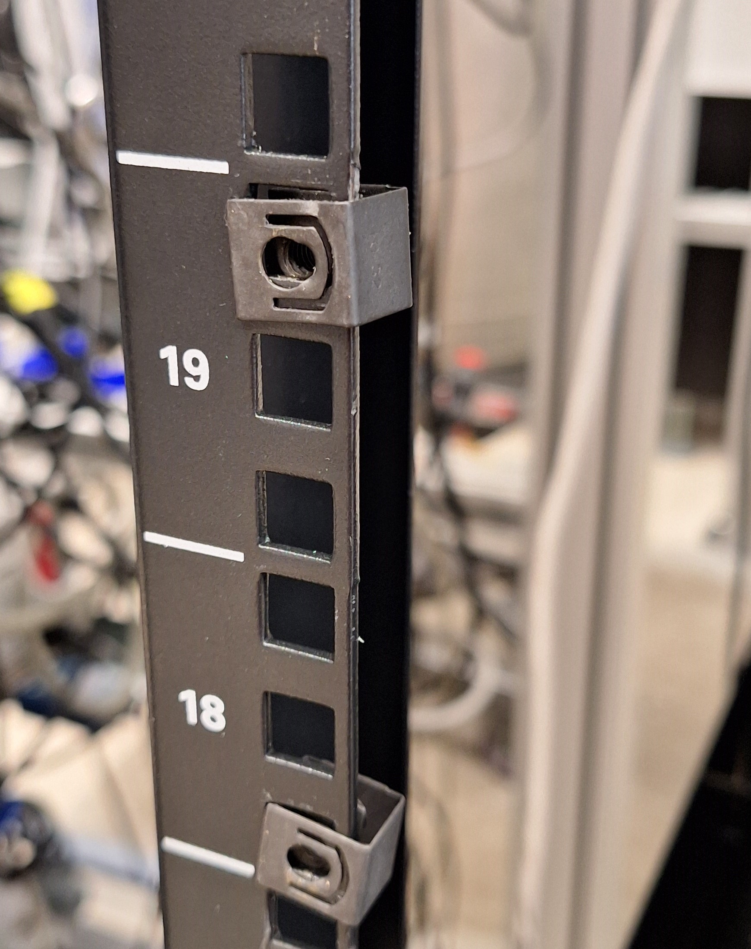
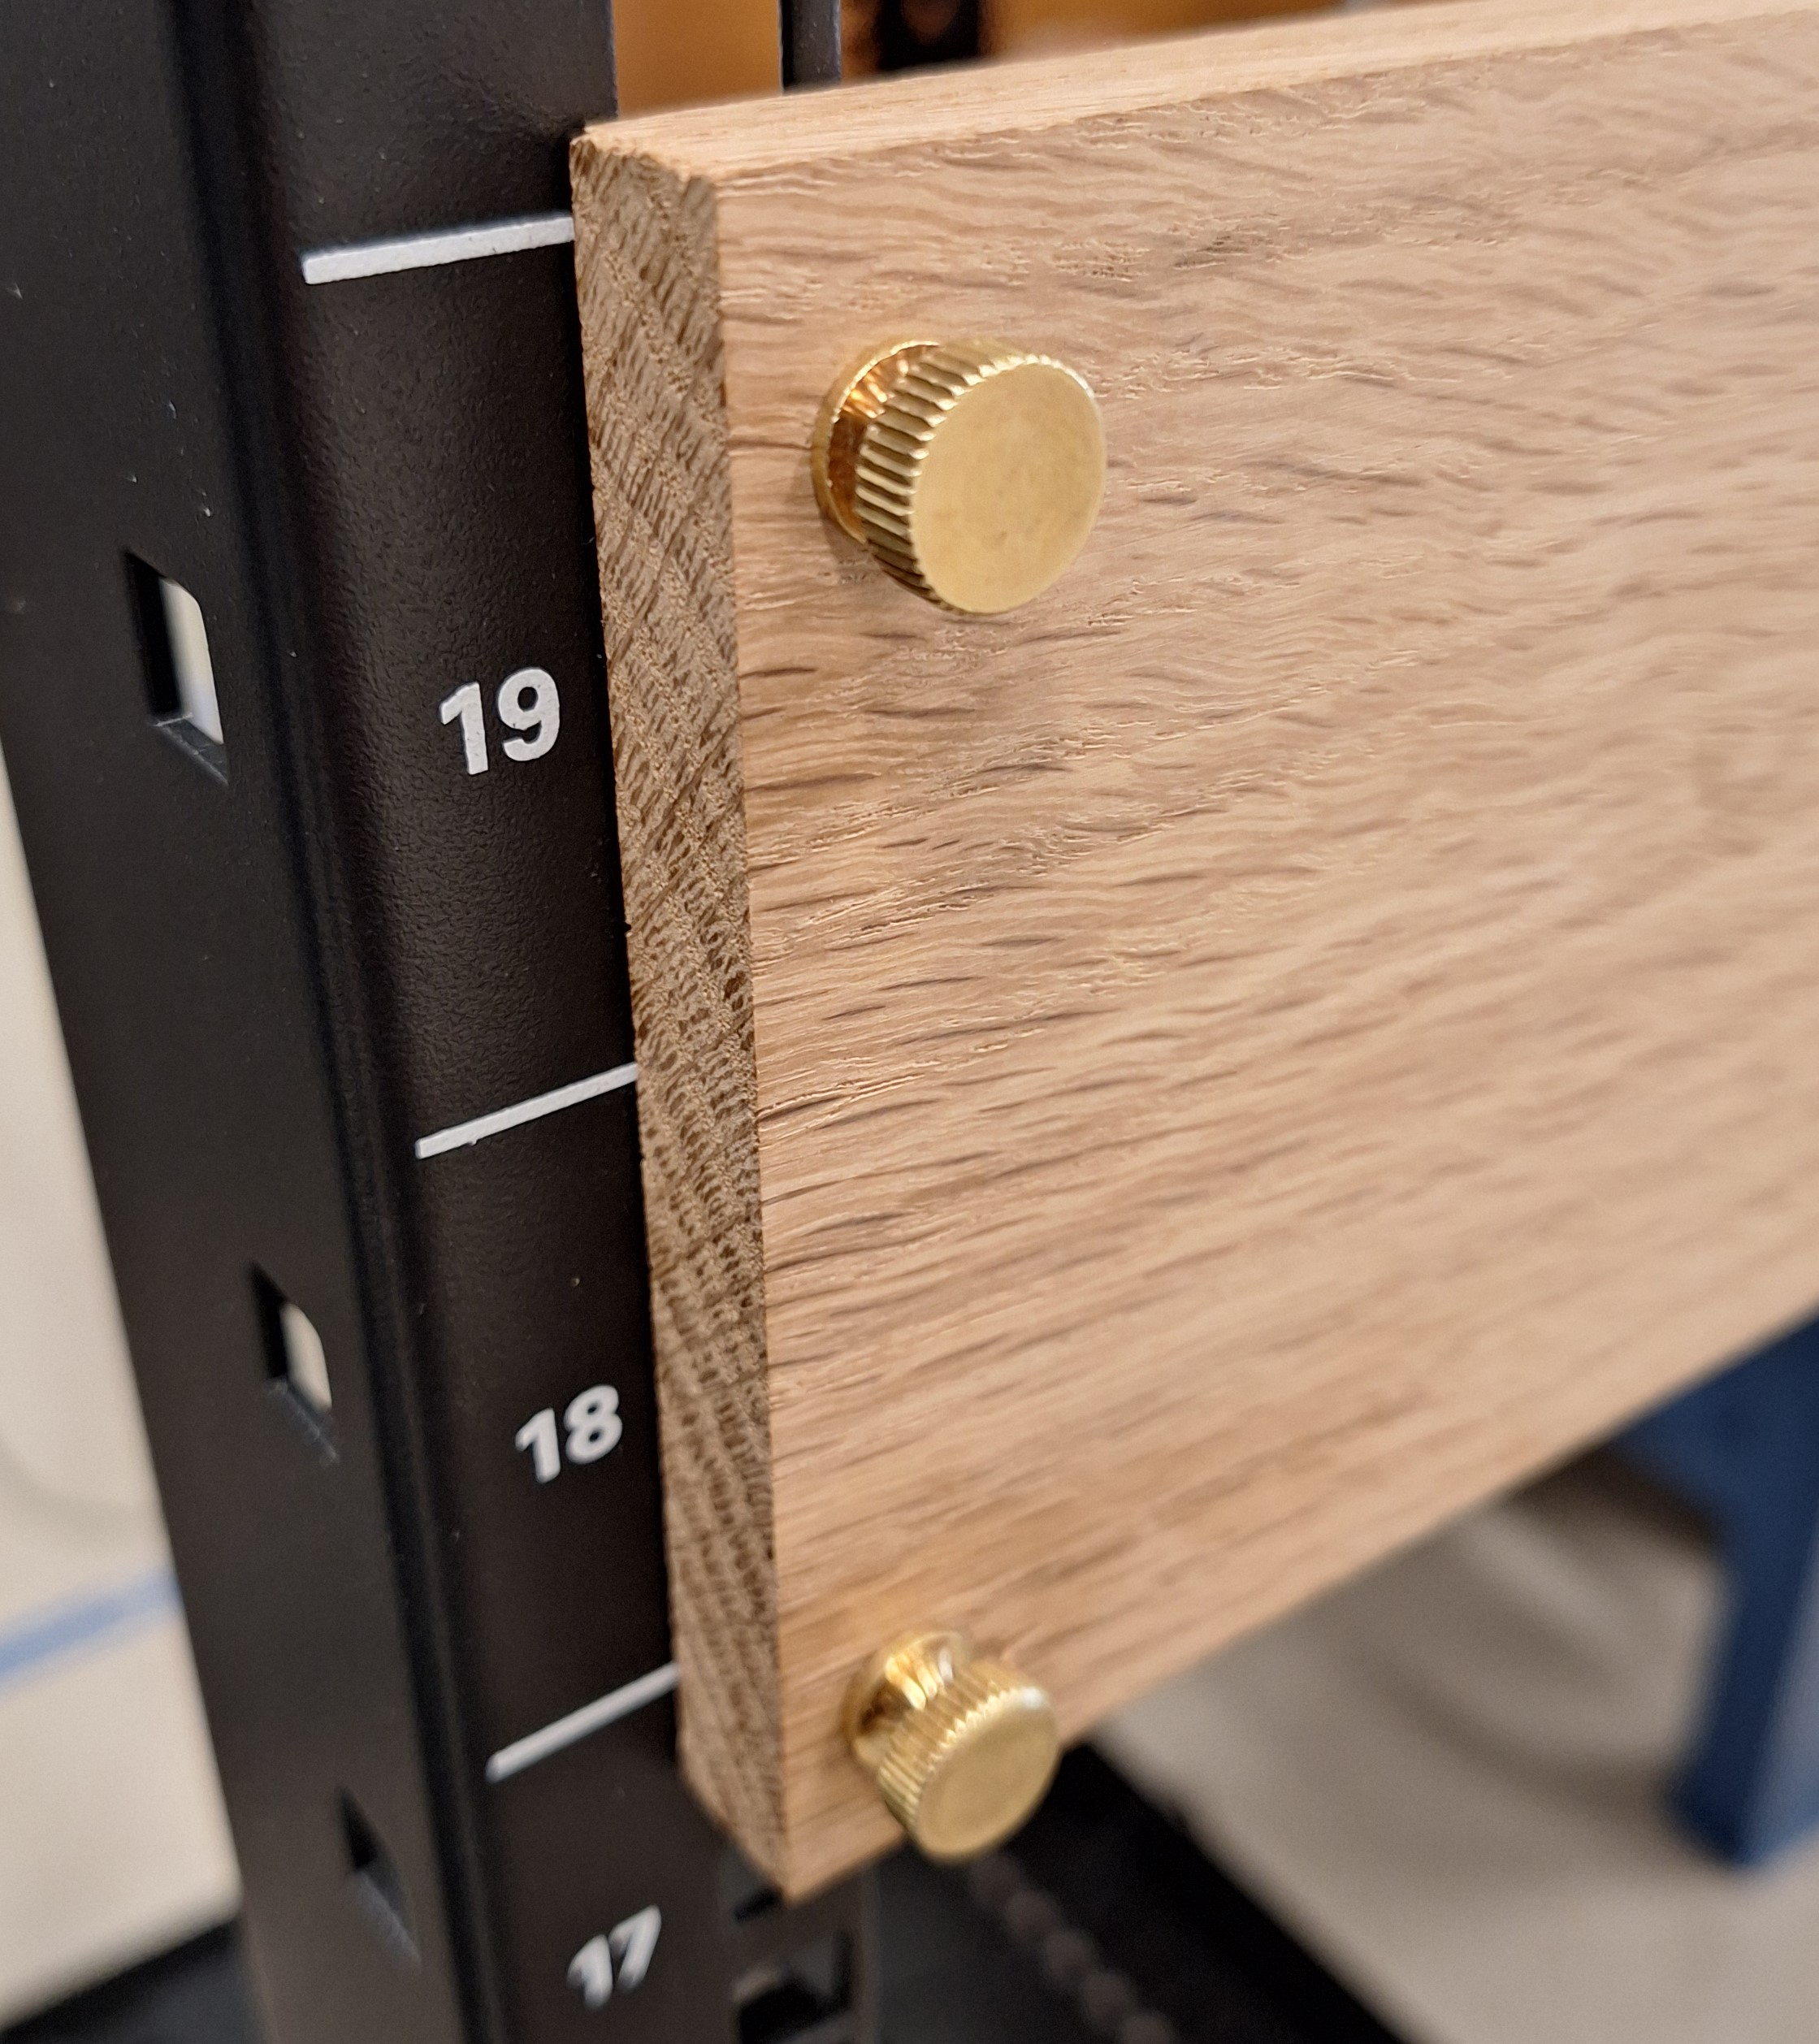
Rack, nut and thumb screw detail

Slide 16
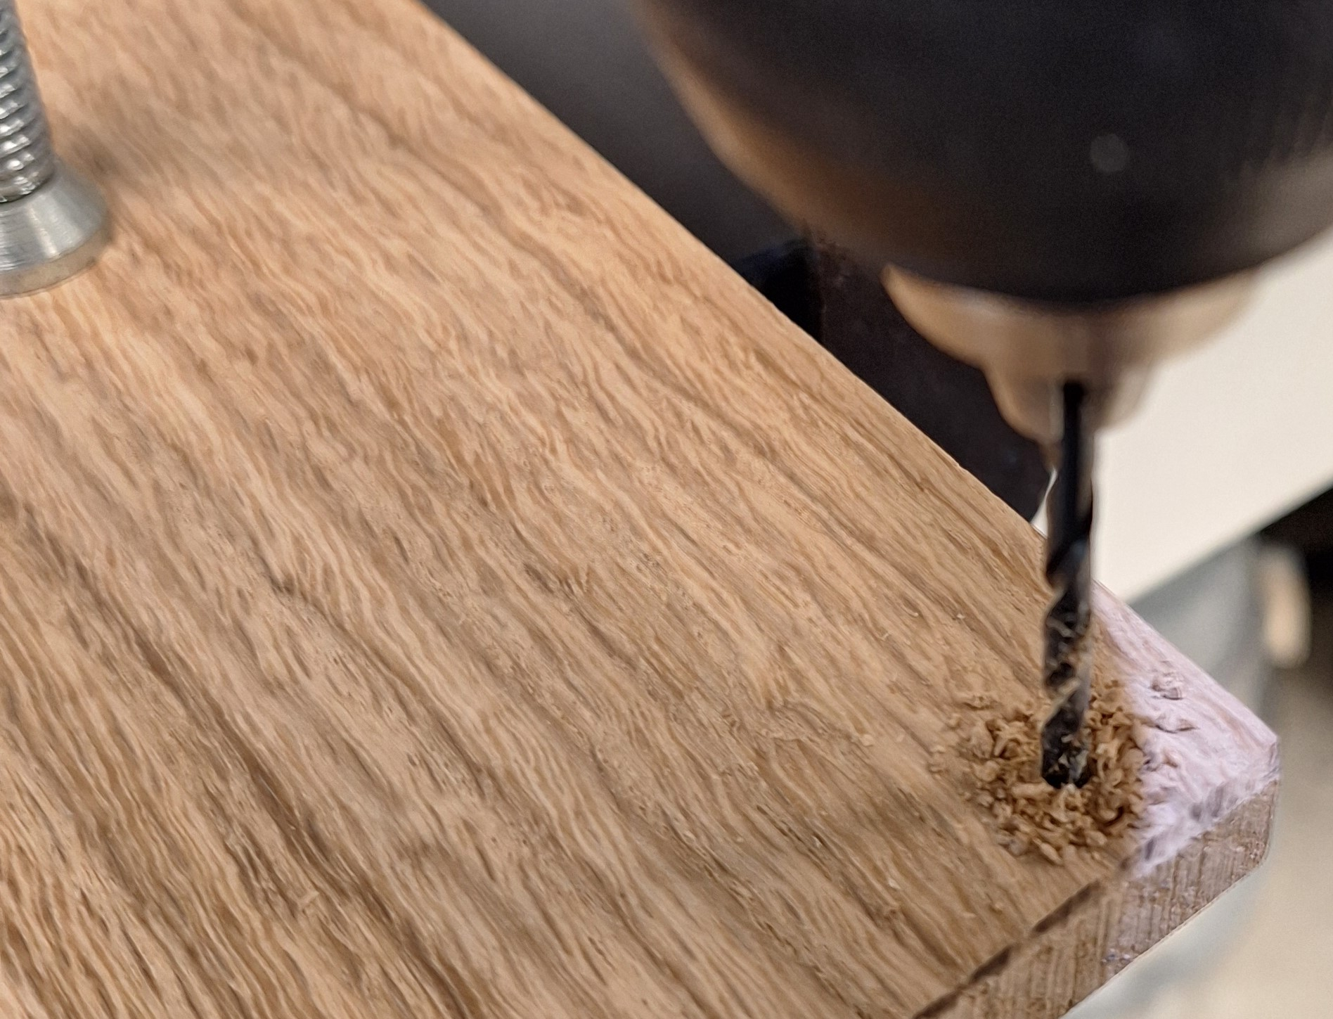
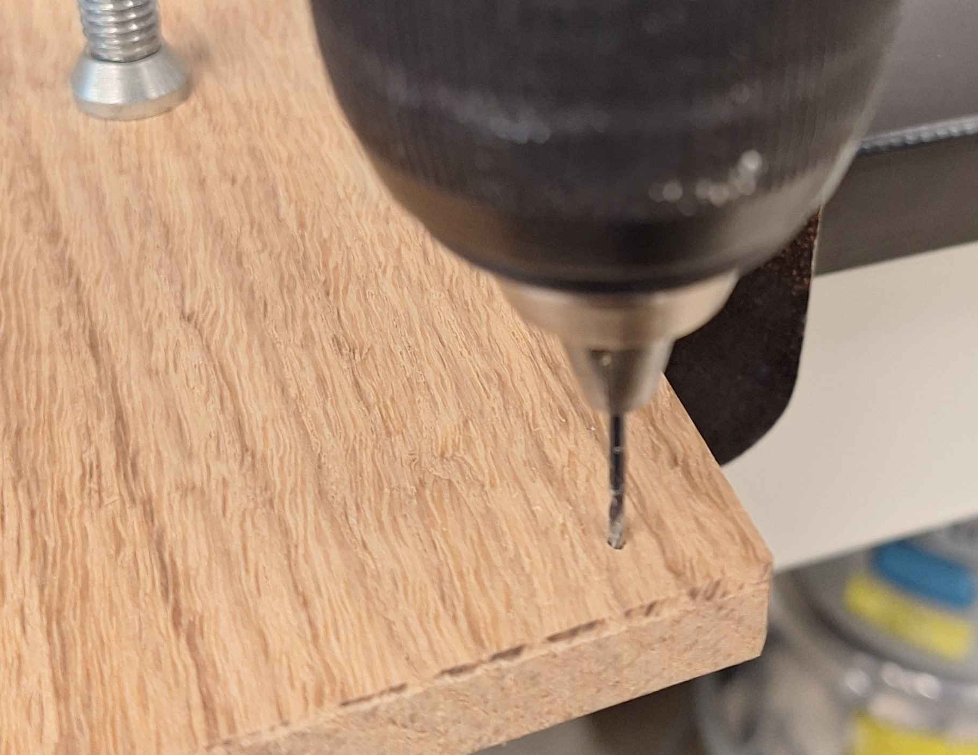
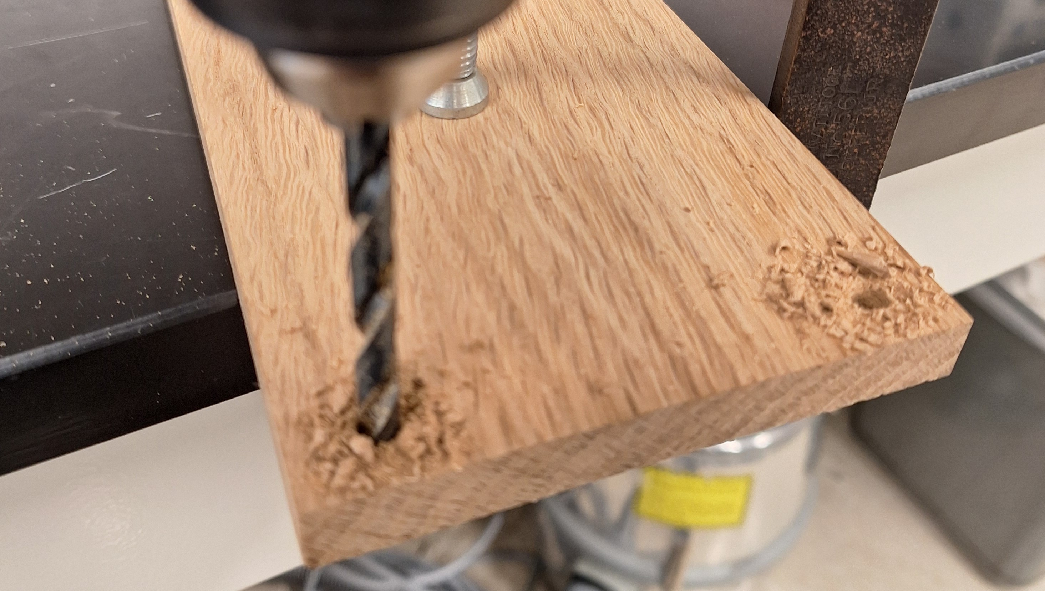

Slide 17
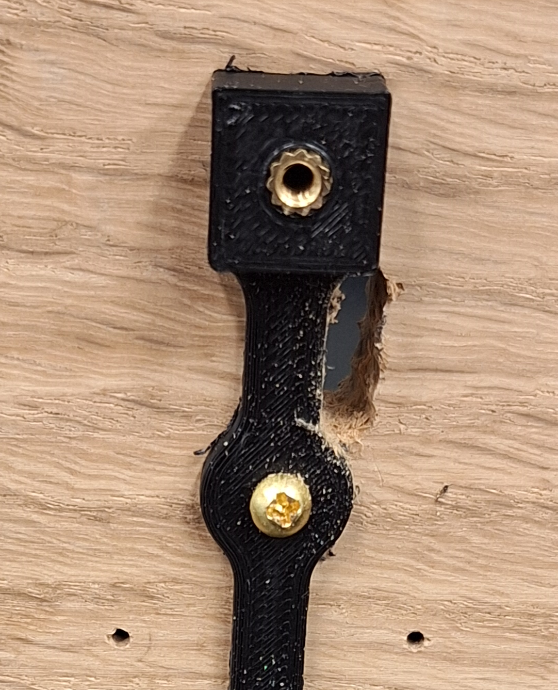
Hand-drilled cutout for 4 pin connector

Slide 18
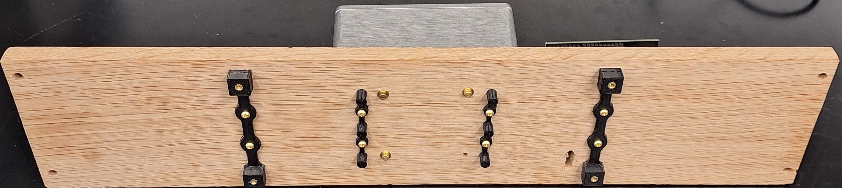
Full assembly with Bud Box and 3d printed parts

Slide 19
Custom Metal Box
MEMSDuino
Lafe Spietz
NIST
2024

Slide 20
Abstract
This is a custom metal box which contains the relay board that connects 90 volts to selected pins on a Dsub connector in the lid. The base of the box is attached to a wood board by 4 screws, and the 90 volt boost board is attached to the inside by means of a bracket screwed to the box. This box fully encloses the 90 volts at room temperature for safety.
MEMSDuino

Slide 21
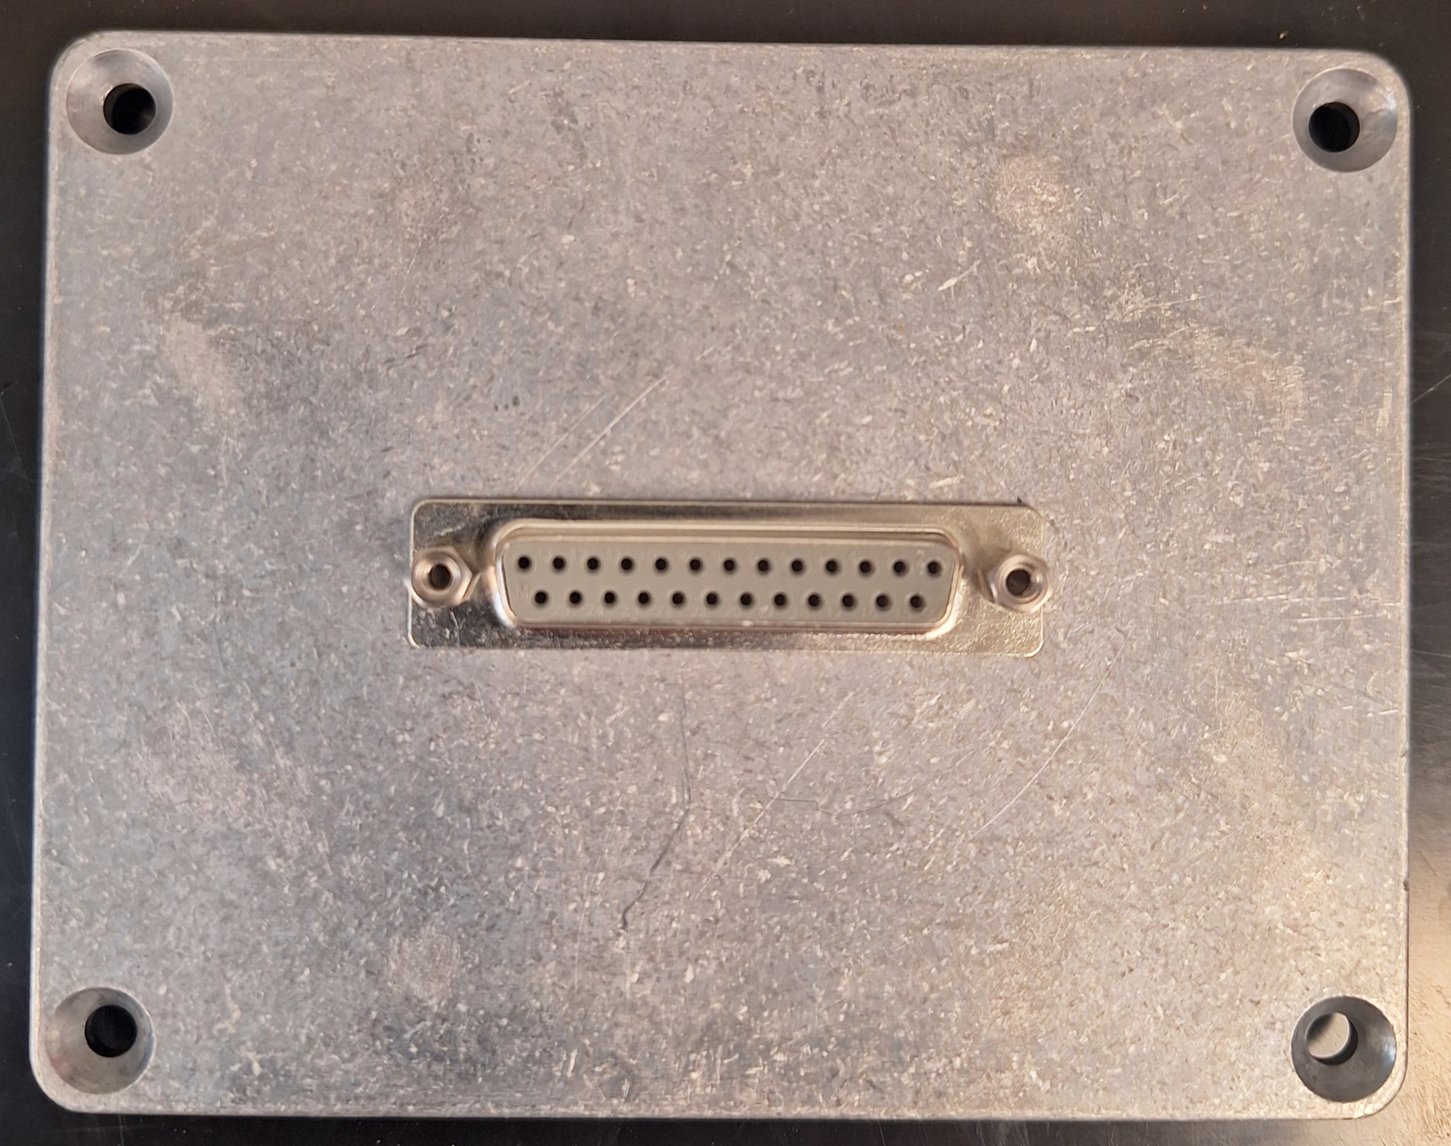
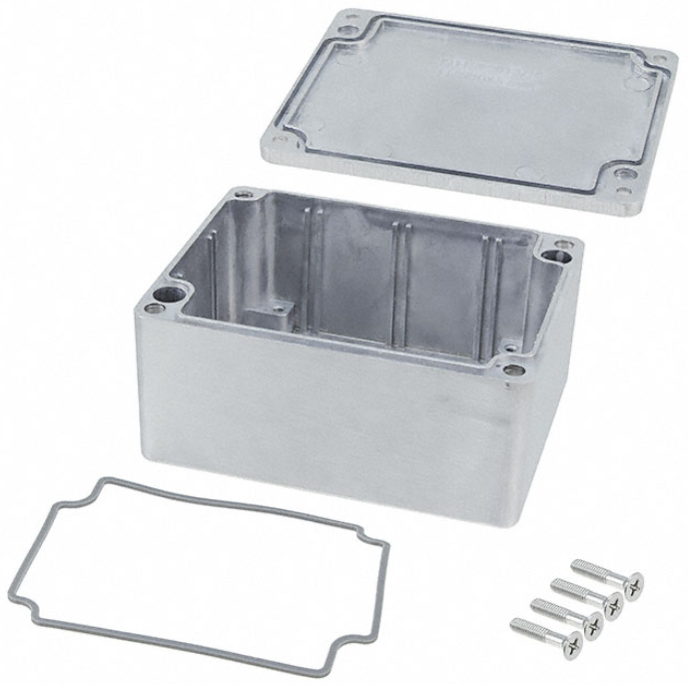
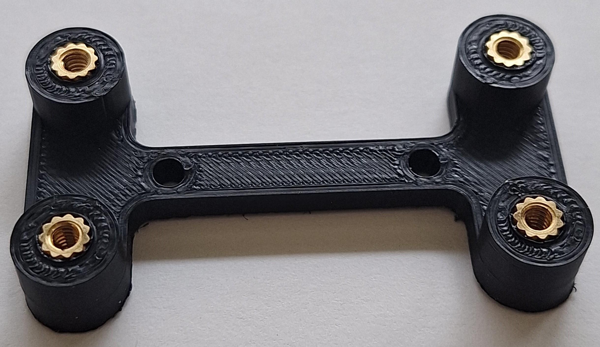
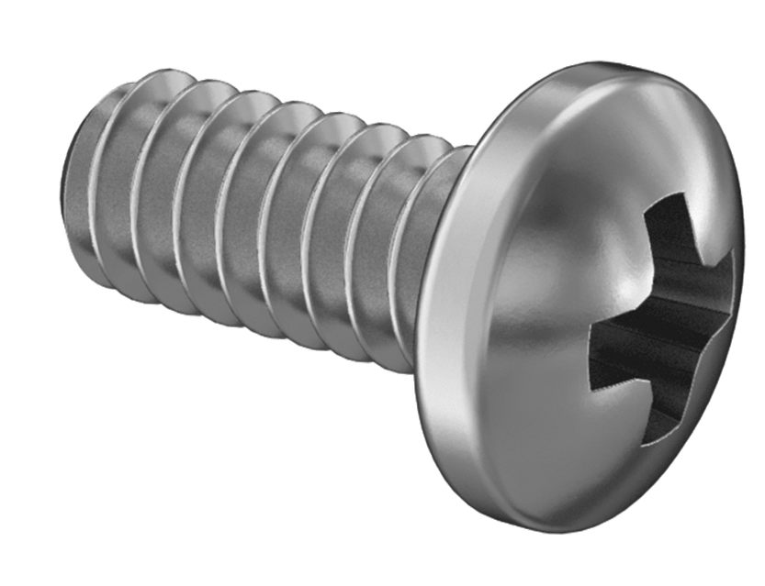
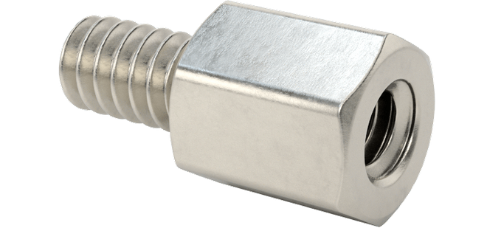
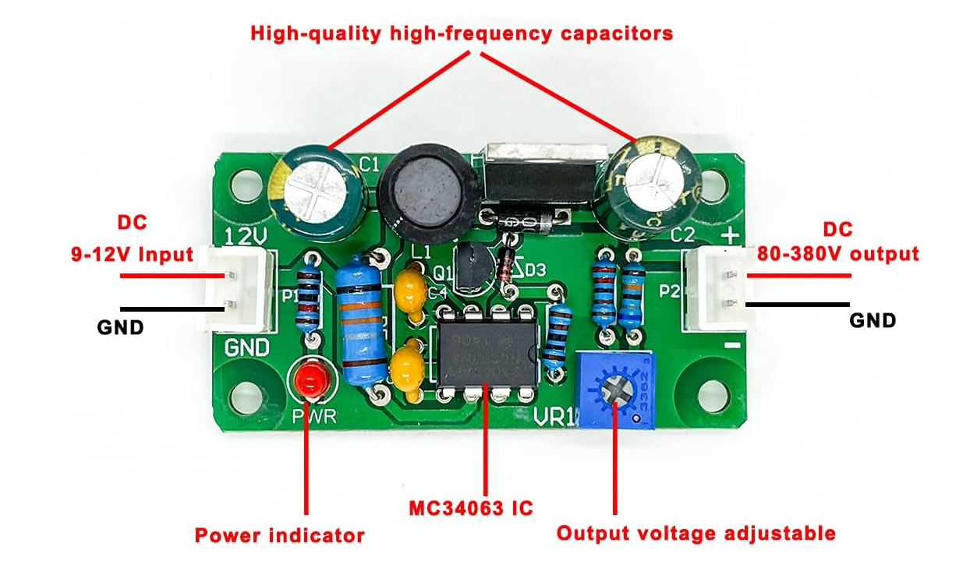
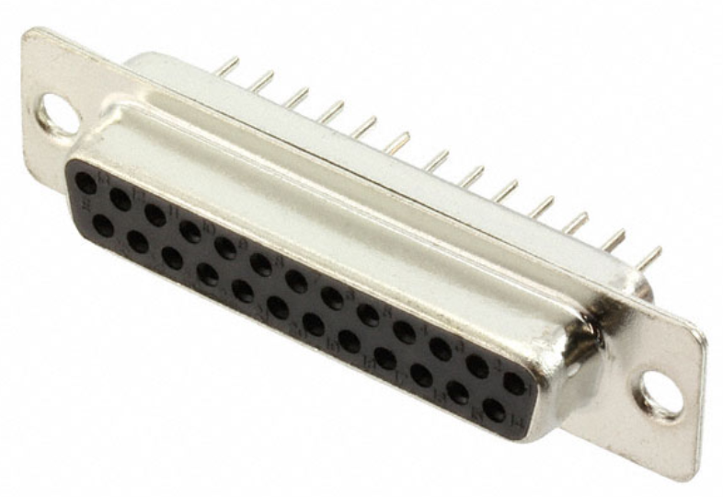
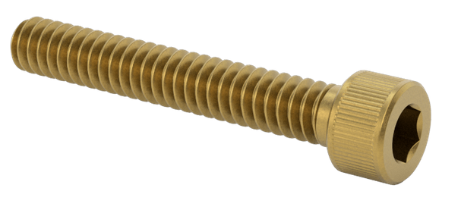
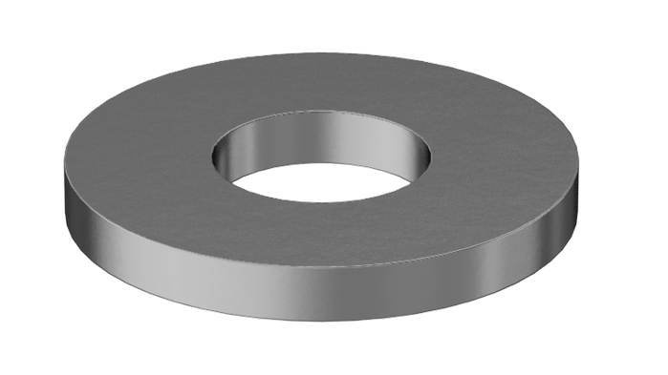
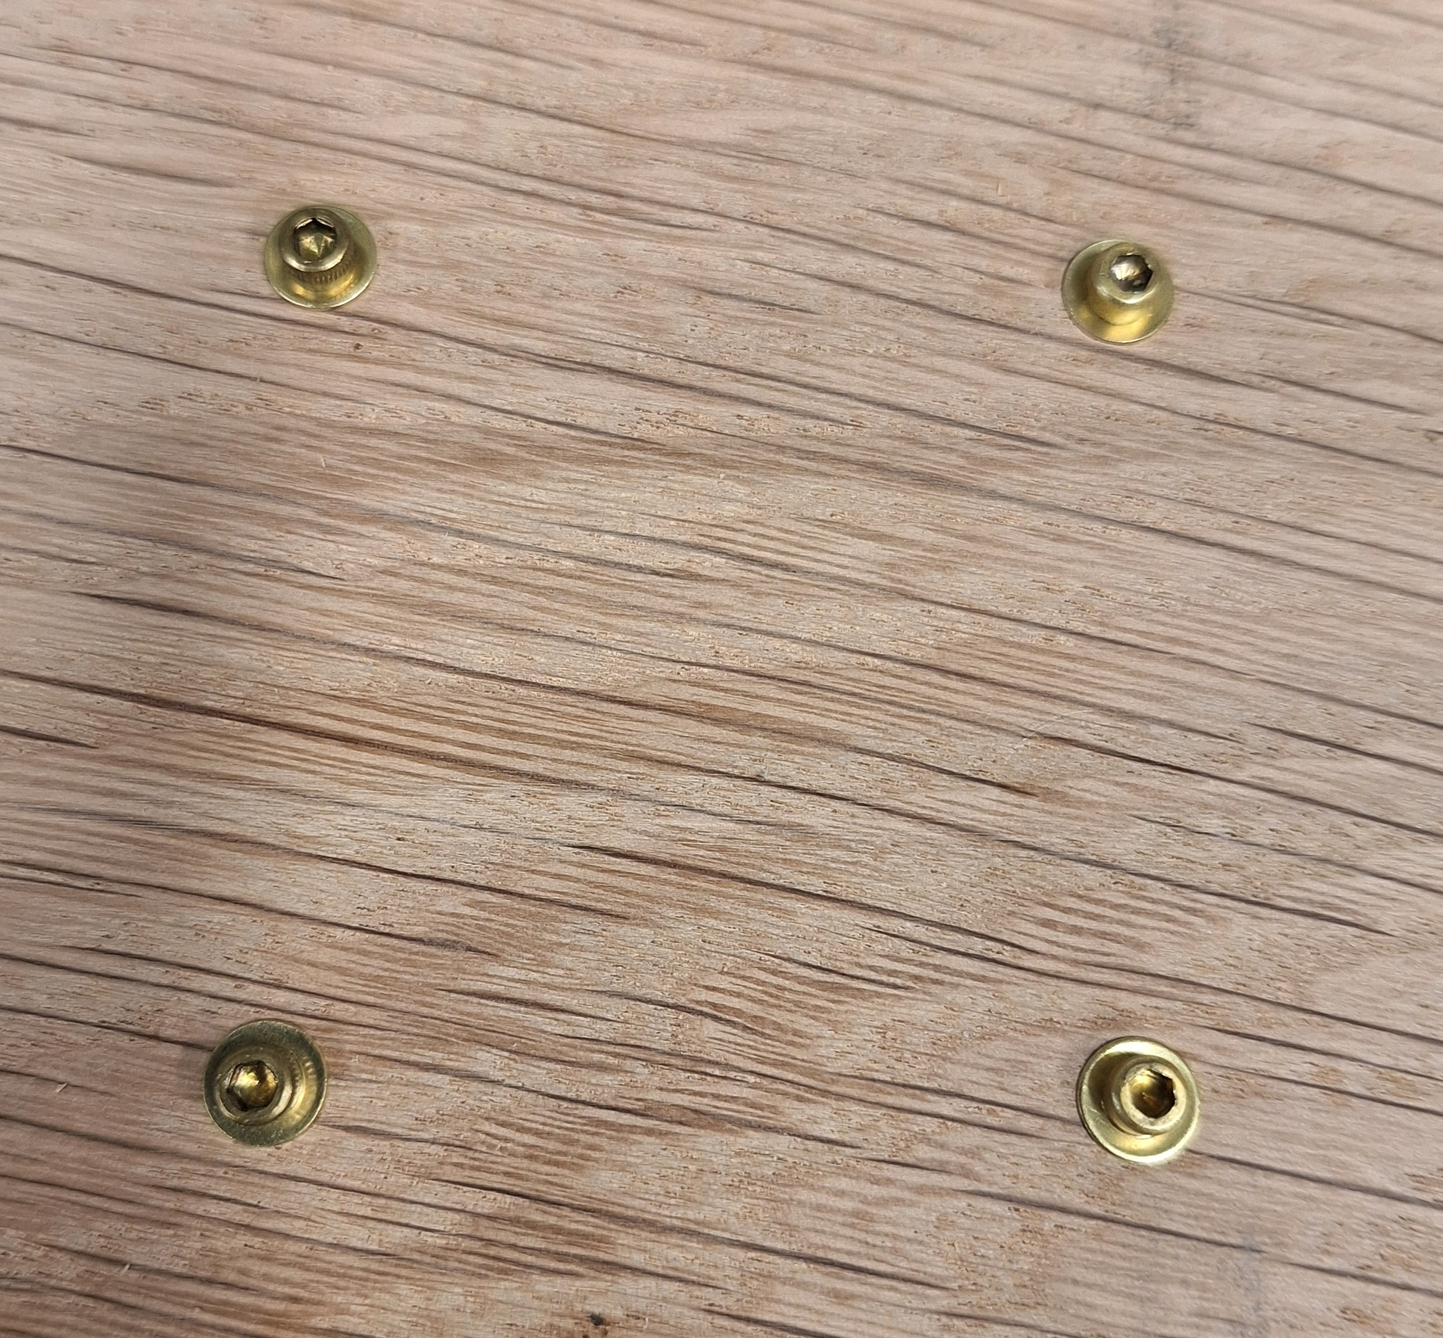
X6
X2
¼” 4-40 screws
HV-DCDC-bracket
7/32” 4-40 standoff
Bud AN-1304-A Diecast Aluminum Box
¾” 4-40 screws
X4
12V to 90 V Boost
#40 washers
Rack Mount Wood Board
MEMSDuino

Slide 22
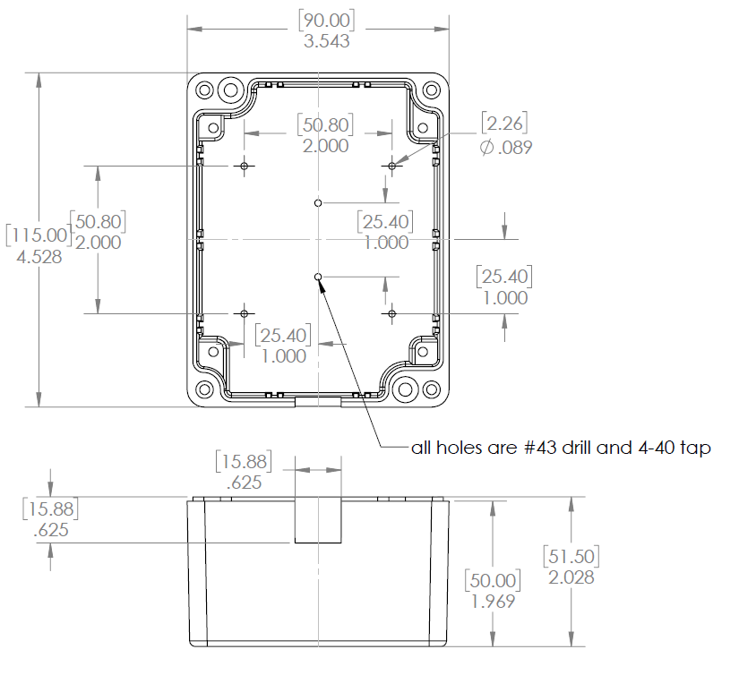
Modify or buy already-modified AN-1304-A box as follows:
MEMSDuino

Slide 23
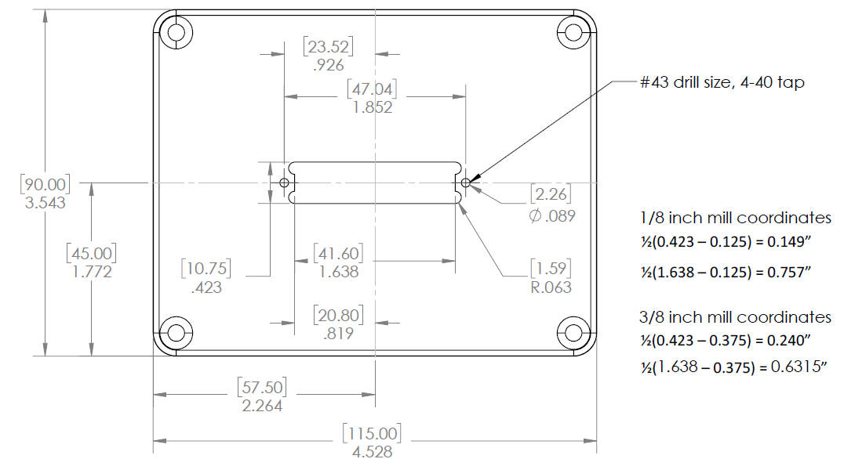
Modify or buy already-modified AN-1304-A lid as follows:
MEMSDuino

Slide 24
Screw DB25 Connector to lid using 7/32” 4-40 standoffs:
MEMSDuino

Slide 25
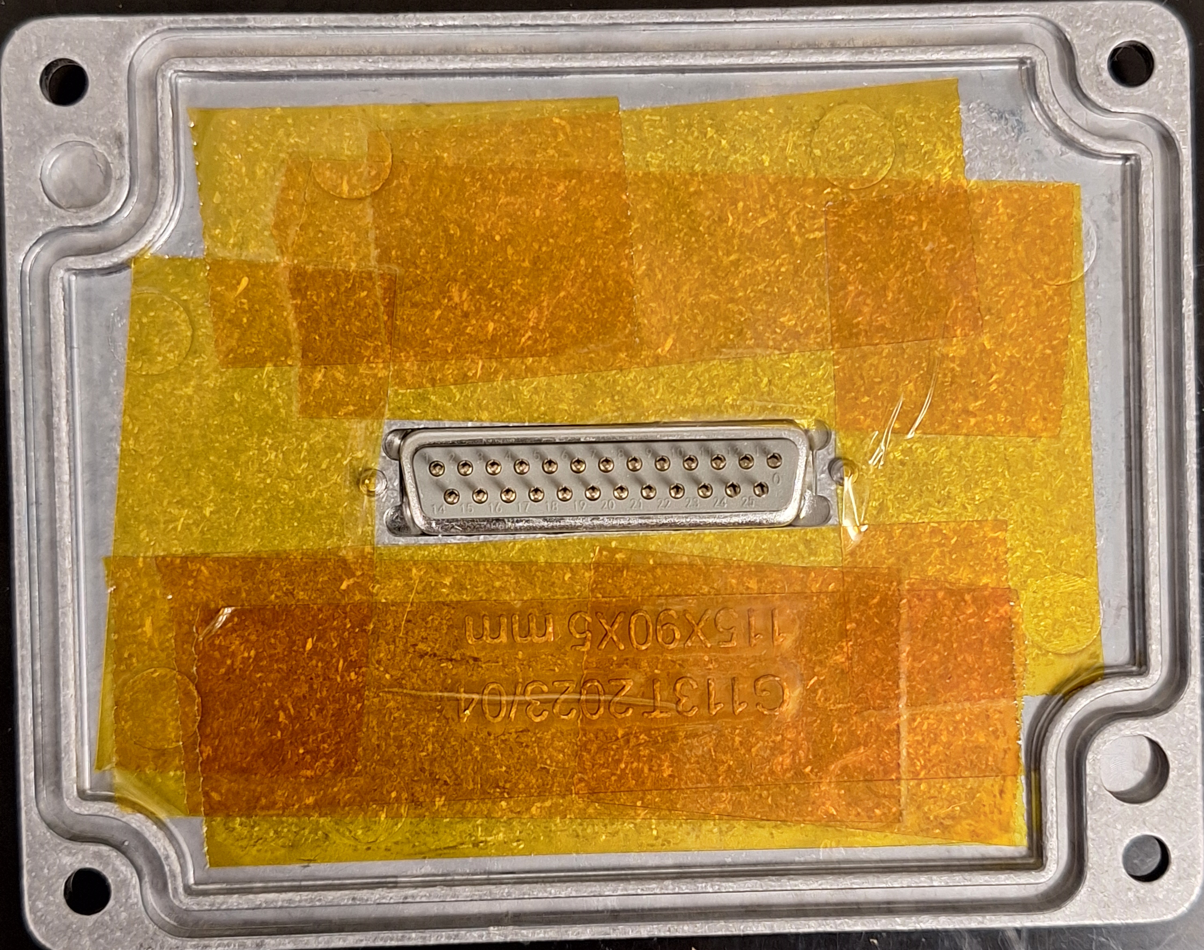
Add polyimide tape to lid to prevent possible shorts
MEMSDuino

Slide 26
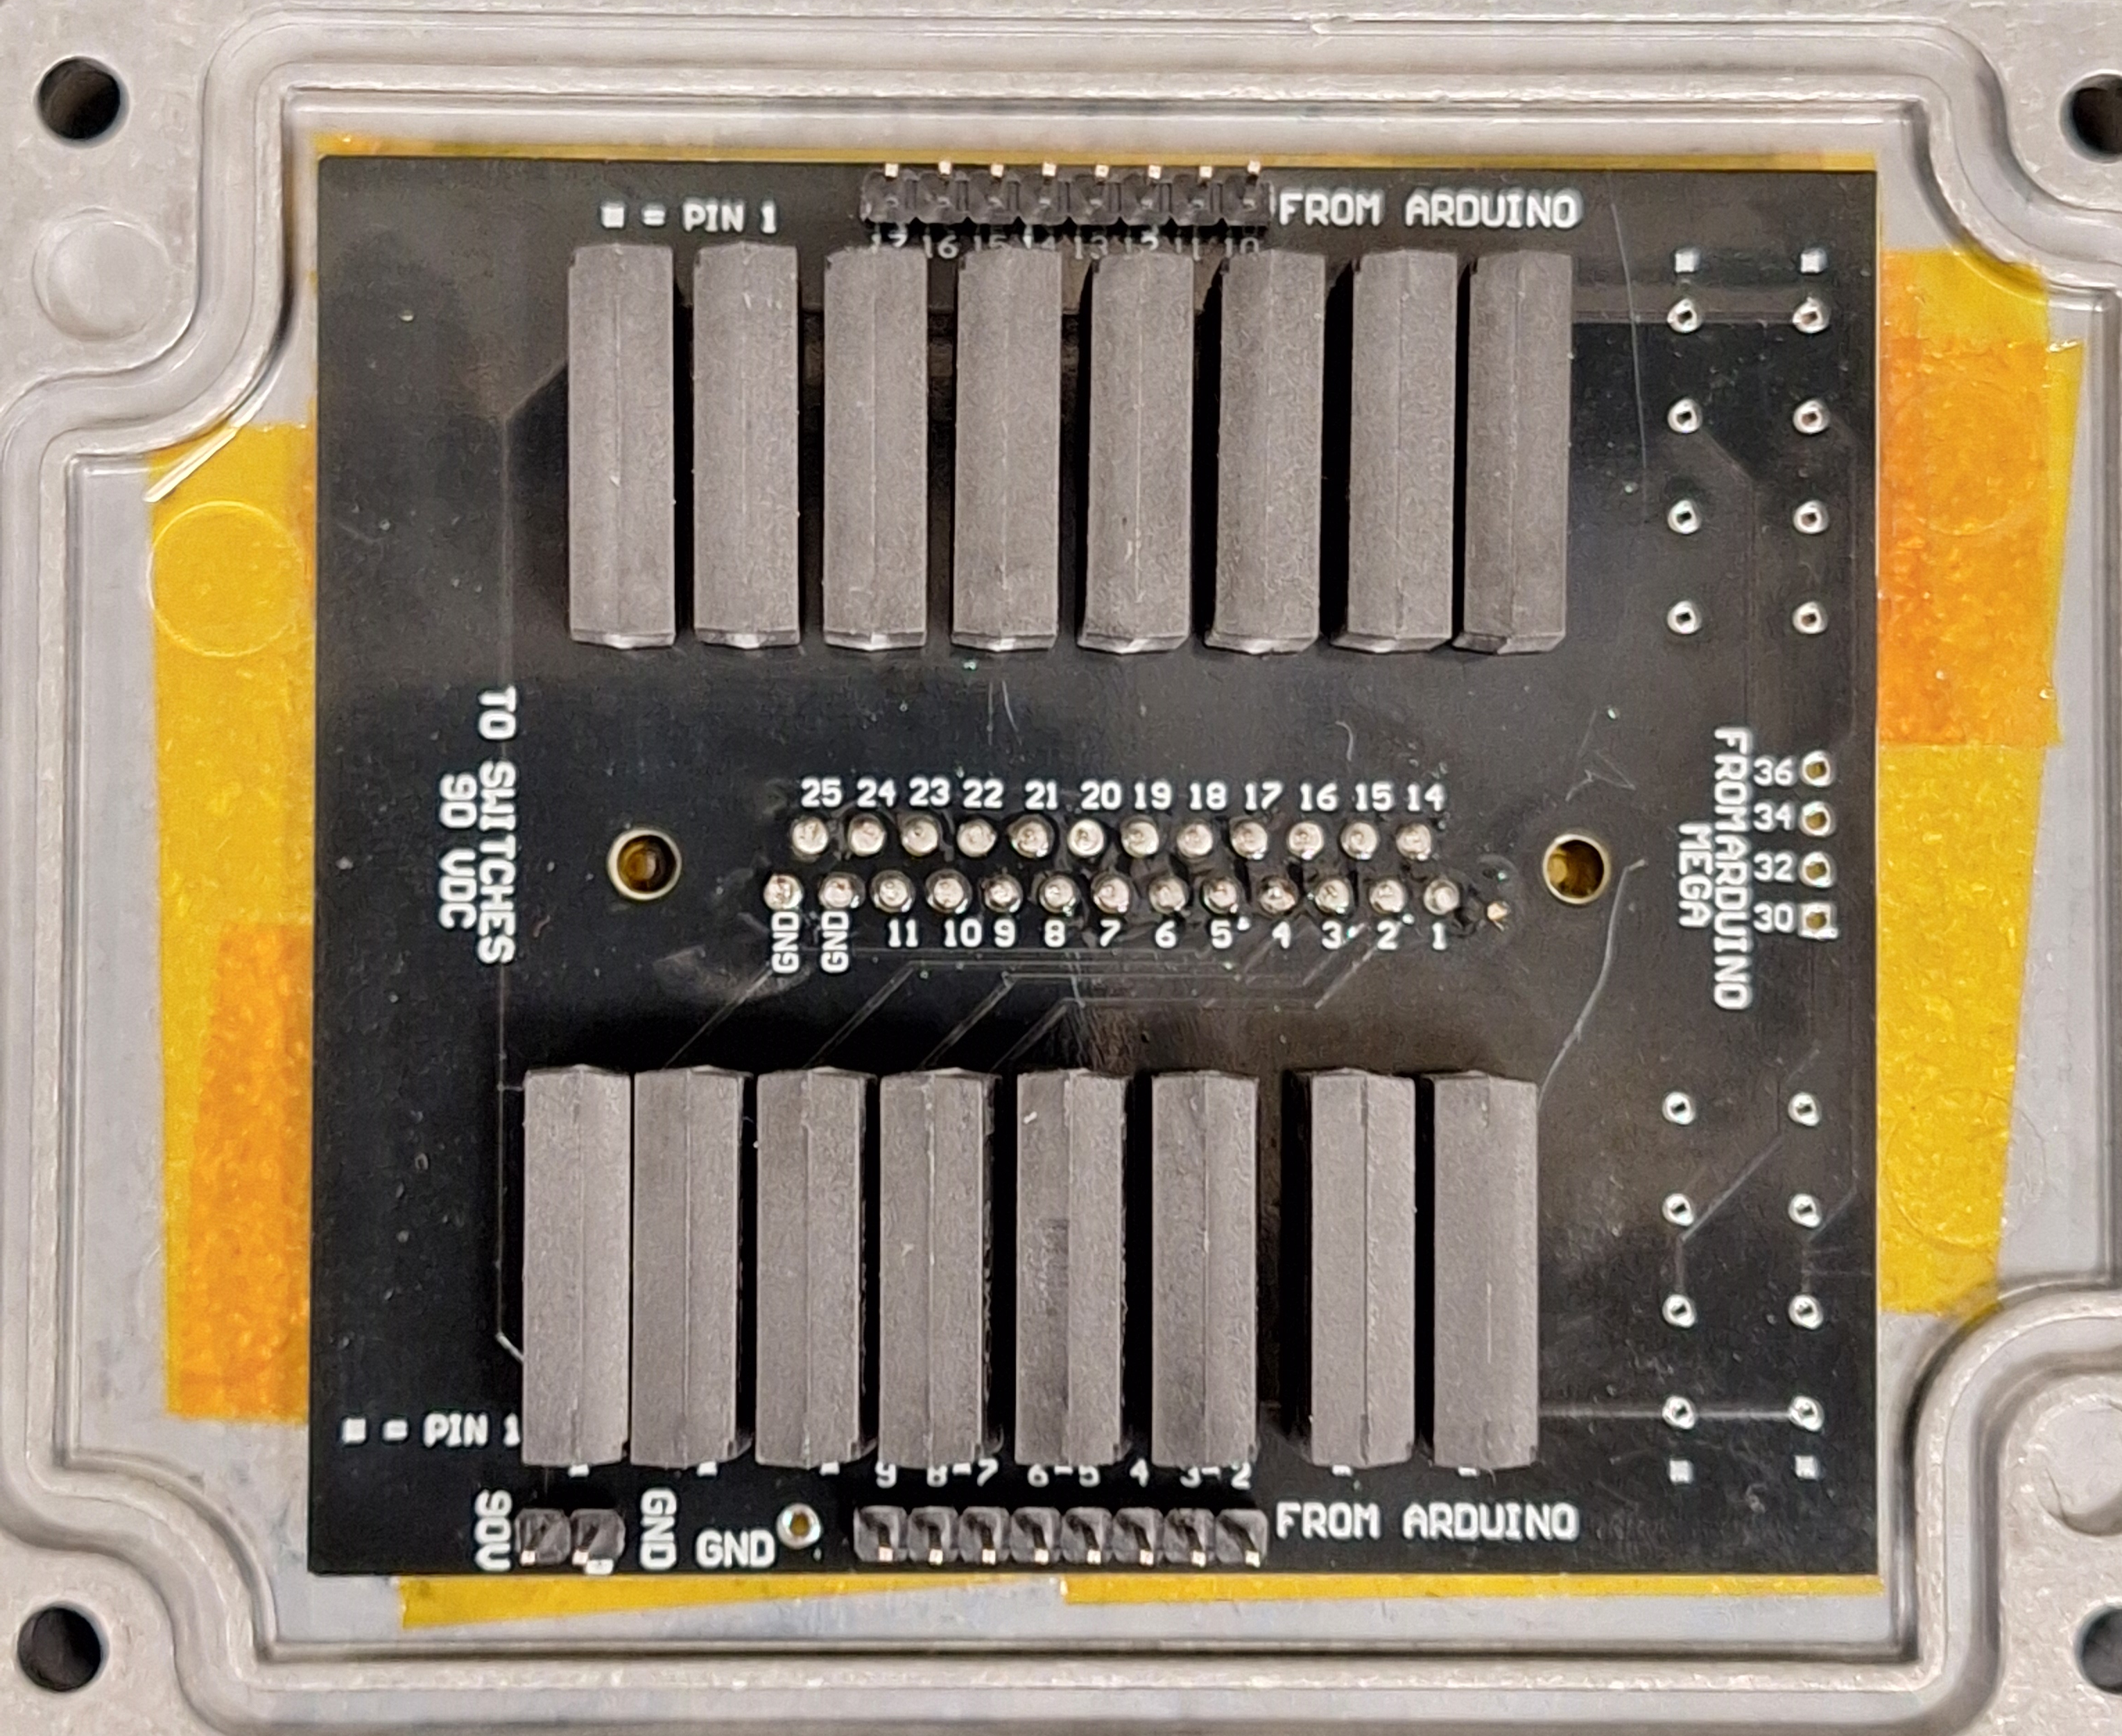
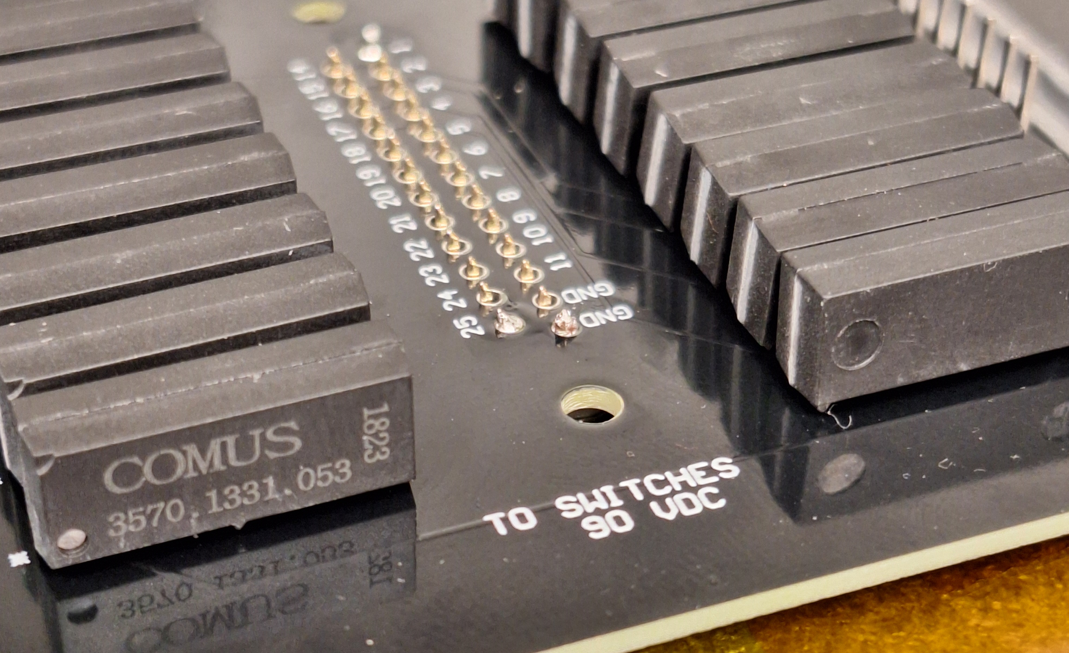
Solder already-assembled DB25 relay circuit board to DB25 connector, adding some space deliberately along the pins
MEMSDuino

Slide 27
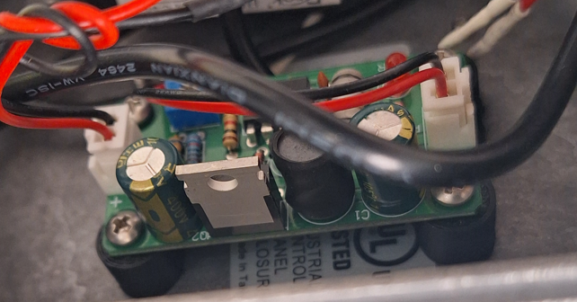
Use 4-40 screws to assemble the DCDC HV mounting bracket to the box, and the high voltage boost board to the bracket
X6
MEMSDuino

Slide 28
Use ¾” 4-40 screws to attach the main box to the wood board, with washers for each screw:
X4
Be sure to orient box so that hole for cables points towards Arduino.
MEMSDuino

Slide 29
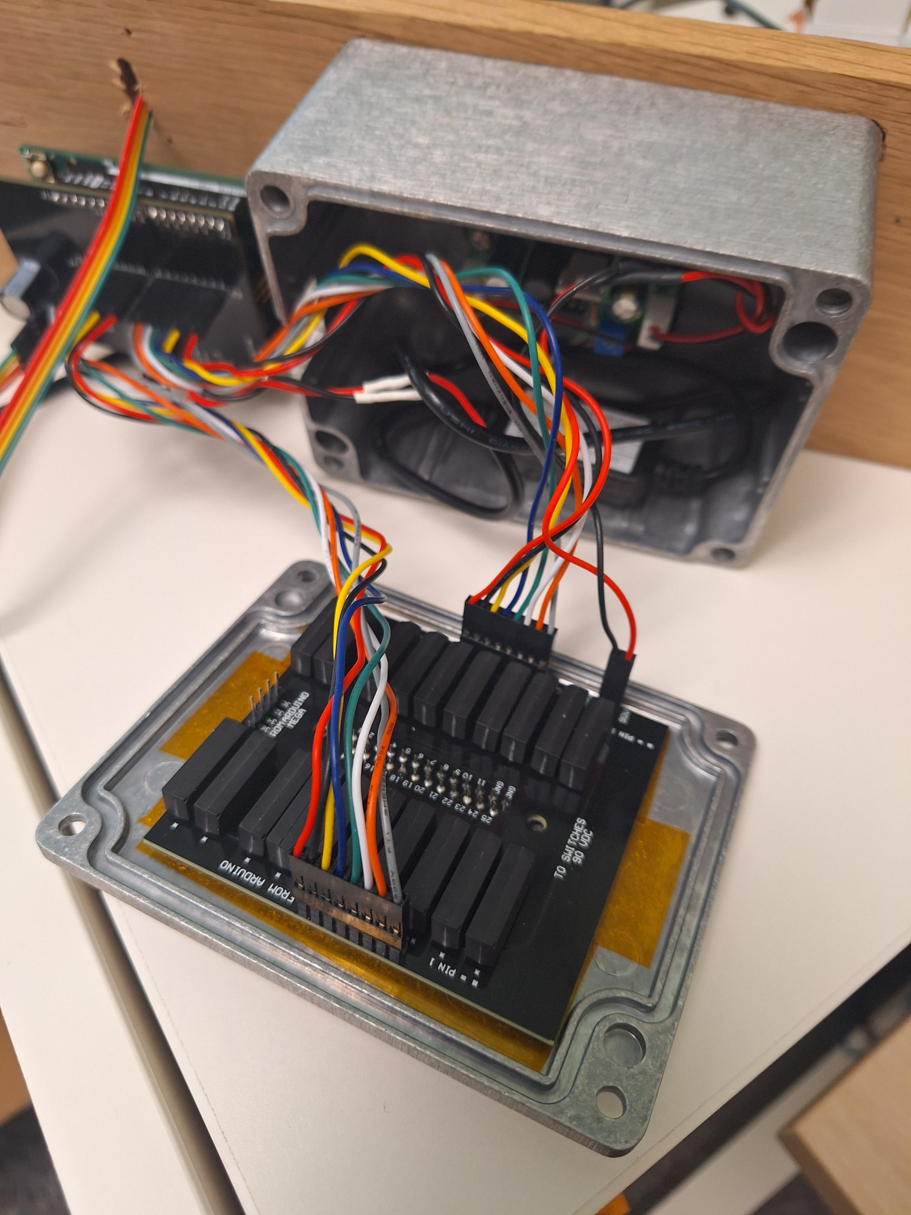
Assemble cables, matching red wire to lowest pin number on both ends, being careful to keep track of which 8 pin cable is which.
MEMSDuino

Slide 30
Conclusions:
The captive circuit board is not ideal, and a better design might make this slightly mor modular. It would also be useful if someone were to get these made in some volume and sold fully machined.
MEMSDuino

Slide 31
5V to 90V Boost
MEMSDuino
Lafe Spietz
NIST
2024

Slide 32
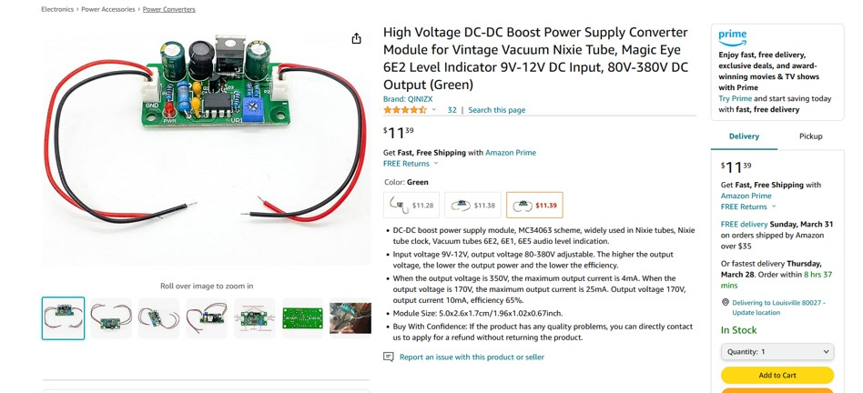


Bill of Materials
https://www.amazon.com/Voltage-Converter-Vintage-Indicator-80V-380V/dp/B09D93QNYK
https://www.amazon.com/DROK-Boost-Converter-Regulator-Length/dp/B09M3LMSS3/
https://www.amazon.com/ZYAMY-Dupont-Connector-Multicolor-Breadboard/dp/B0B8Z23NWX/
MEMSDuino

Slide 33



Tools and Consumables
MEMSDuino

Slide 34




90 Volt to DB25 Relay Board Cable Assembly
MEMSDuino

Slide 35



5V to 12 V Cable Assembly
MEMSDuino

Slide 36



Setting the voltage output to 90V
MEMSDuino

Slide 37

Arduino UNO Shield Connection
5V to Boost
MEMSDuino

Slide 38
3D Printed Parts
Lafe Spietz
NIST
Summer 2024

Slide 39

Full Set of Parts
arduino-bracket.STL
HV-DCDC-bracket.STL
front-panel-edge-bracket.STL
front-panel-center-bracket.STL

Slide 40
Print times and filament masses
arduino-bracket.STL: 4 grams, 18 minutes, print 1
HV-DCDC-bracket.STL: 4 grams, 14 minutes, print 1
front-panel-center-bracket.STL: 1 gram/each, 7 minutes/each, print 2
front-panel-edge-bracket.STL: 4 grams/each 14 minutes/each, print 2
Total filament mass: 18 g
Total print time: 77 minutes

Slide 41




Slide 42

4-40 Thread Inserts
Insert with soldering iron, in a press if available

Slide 43
DB25 Relay Circuit Baord
MEMSDuino
Lafe Spietz
NIST
2024

Slide 44
Abstract
This board uses electromechanical relays to connect the 90 volt line with any of 20 pins on a DB25 (25 pin DSUB) board mount connector which is in the lid of the custom metal box. In the 9 way switch, 16 of these lines are actually used.
MEMSDuino

Slide 45




Order Components
5 V relay
1 Mohm resistor 1206 SMT package
https://www.digikey.com/en/products/detail/yageo/RC1206FR-071ML/728388
https://www.digikey.com/en/products/detail/comus-international/3570-1331-053/7497099
0.1” headers, 40 pin strips x1
DB 25 Board Mount Connector
https://www.amazon.com/Header-Lystaii-Pin-Connector-Electronic/dp/B06ZZN8L9S/
https://www.digikey.com/en/products/detail/assmann-wsw-components/A-DF-25-PP-Z/1241794
MEMSDuino

Slide 46


Order Circuit Boards
https://www.pcbway.com
78.74 x 71.12 mm
(3.1 x 2.8 in) size
Black solder mask
White silkscreen
1.6mm FR4
https://github.com/lafefspietz/MEMSduino/raw/main/PCB_files/DB25-relay-HV-control-gerbers.zip
MEMSDuino

Slide 47

Assemble Kit
MEMSDuino

Slide 48
Lift board up when soldering to increase clearance
MEMSDuino

Slide 49
Assembly
MEMSDuino

Slide 50

MEMSDuino

Slide 51

MEMSDuino

Slide 52
Adding polyimide tape to the lid
This must be assembled before the circuit board is soldered to the DB25 connector!
Prevent potential shorts
MEMSDuino

Slide 53
Relay
https://www.digikey.com/en/products/detail/comus-international/3570-1331-053/7497099
MEMSDuino

Slide 54
Conclusions:
The fact that the DB25 connector causes the whole board to be captive is not ideal. An improvement would be some kind of socket and cable alternative which can be unplugged. There are a number of ways this might be done.
MEMSDuino

Slide 55
Arduino Shield Circuit Board
MEMSDuino
Lafe Spietz
NIST
2024

Slide 56


Order Custom Circuit Boards
https://www.pcbway.com
71.12 x 53.34 mm (2.1” x 2.8”) size
Black solder mask
White silkscreen
1.6mm FR4
https://github.com/lafefspietz/MEMSduino/raw/main/PCB_files/arduino-to-headers-shield-gerbers.zip
MEMSDuino

Slide 57

330 Ohm resistor x1
100 kOhm resistor x1
https://www.digikey.com/en/products/detail/stackpole-electronics-inc/RNF14FTD100K/1706591
https://www.digikey.com/en/products/detail/stackpole-electronics-inc/CF18JT330R/1741683
0.1” headers, 40 pin strips x2
1000 uF Capacitor x1
https://www.digikey.com/en/products/detail/rubycon/16PK1000MEFC10X12-5/3563556
https://www.amazon.com/Header-Lystaii-Pin-Connector-Electronic/dp/B06ZZN8L9S/
MEMSDuino

Slide 58
Break off strips to correct lengths:
MEMSDuino

Slide 59

Assembly
MEMSDuino

Slide 60

0.1” Header Cables: 8 pin, 6” long to connect to DB25 Relay Circuit Board
https://www.amazon.com/ZYAMY-Dupont-Connector-Multicolor-Breadboard/dp/B0789F2Y1T/
2x
MEMSDuino

Slide 61


Slide 62


Slide 63

Assembly with cables
MEMSDuino

Slide 64
Control Panel Circuit Board
MEMSDuino
Lafe Spietz
NIST
2024

Slide 65
Abstract
This is the control panel, where a human operator pushes buttons to set the state of the switch and can see indicator lights which display the state of the switch. Indicator lights are programmable RGB LED’s and buttons connect an analog pin on the Arduino to a resistor ladder.
MEMSDuino

Slide 66


Order Circuit Boards
228.6 x88.9 mm size
Black solder mask
White silkscreen
1.6mm FR4
https://www.pcbway.com/
9button-9neopixel
https://github.com/lafefspietz/MEMSduino/raw/main/PCB_files/9button-9neopixel-gerbers.zip
MEMSDuino

Slide 67

Order Components
4 Wire Header cable, 6” long x1
Button x9
https://www.amazon.com/ZYAMY-Dupont-Connector-Multicolor-Breadboard/dp/B0789F523N/
https://www.digikey.com/en/products/detail/e-switch/TL59NF160Q/390533
10 kOhm axial resistor x9
NeoPixel RGB programmable LED x9
https://www.digikey.com/en/products/detail/yageo/MFR-25FBF52-10K/13219
https://www.adafruit.com/product/1559
MEMSDuino

Slide 68

Assembly
MEMSDuino

Slide 69

Backside Detail of cable connection
MEMSDuino

Slide 70

Dimensioned Drawing
MEMSDuino

Slide 71

Button Ladder Schematic
Buttons connect analog line A4 on the Arduino to different nodes in a ladder of resistors which spans from 5 volts to a node just above ground. The analog line has a 100k pull down resistor on the Arduino Shield Circuit Board.
MEMSDuino

Slide 72

PCB Layout
Created in Altium Designer
MEMSDuino

Slide 73
Conclusions:
This board should get either replaced by or integrated into panels like the ones from frontpanelexpress.com for a more professional finish. These are cheaper and easier to rapid prototype, however.
MEMSDuino

Slide 74
SP6T Control System
MEMSDuino
Lafe Spietz
NIST
2024

Slide 75
Abstract
This circuit board
MEMSDuino

Slide 76

Rack Mount Controller

Slide 77


https://www.cryoelec.com/products/cryoswitchsp6t

Slide 78




Slide 80
Order Components
4 Wire Header cable, 6” long x1
Button x6
https://www.amazon.com/ZYAMY-Dupont-Connector-Multicolor-Breadboard/dp/B0789F523N/
https://www.digikey.com/en/products/detail/e-switch/TL59NF160Q/390533
10 kOhm axial resistor x6
NeoPixel RGB programmable LED x6
https://www.digikey.com/en/products/detail/yageo/MFR-25FBF52-10K/13219
https://www.adafruit.com/product/1559
MEMSDuino

Slide 81



Slide 82

MEMSDuino

Slide 83
Conclusions:
MEMSDuino

Slide 84
SP8T + SOL System
MEMSDuino
Lafe Spietz
NIST
2024

Slide 85
Abstract
This is a phase matched switch from a common RF port to 8 RF ports. There are three levels of switches, the bottom of which exists only to increase isolation, and the top of which has a short, an open, and a load for SOL calibration.
MEMSDuino

Slide 86


Slide 87

Rack Mount Controller

Slide 90
Order Components
4 Wire Header cable, 6” long x2
Button x6
https://www.amazon.com/ZYAMY-Dupont-Connector-Multicolor-Breadboard/dp/B0789F523N/
https://www.digikey.com/en/products/detail/e-switch/TL59NF160Q/390533
10 kOhm axial resistor x6
NeoPixel RGB programmable LED x6
https://www.digikey.com/en/products/detail/yageo/MFR-25FBF52-10K/13219
https://www.adafruit.com/product/1559
MEMSDuino

Slide 91
Conclusions:
MEMSDuino

Slide 92
Micro D to Header Adapter Board Build
MEMSDuino
Lafe Spietz
NIST
2024

Slide 93
Abstract
This circuit board breaks out the MicroD found at the base of many dilution refrigerators into a set of up to 20 lines, each broken out in a pair of identical 4 pin header outputs. Labels are specific to our switch matrix at NIST, but can be adapted to any switch with 20 or fewer lines.
MEMSDuino

Slide 94

Parts
M83513/25-D01CP x1
0.1” headers, 40 pin strips x1
https://www.amazon.com/Header-Lystaii-Pin-Connector-Electronic/dp/B06ZZN8L9S/
https://www.digikey.com/en/products/detail/itt-cannon,-llc/M83513%2F25-D01CP/4803943
MEMSDuino

Slide 95


66 x 44 mm size
Black solder mask
White silkscreen
1.6mm FR4
https://github.com/lafefspietz/MEMSduino/raw/main/PCB_files/microd-header-adapter-board-rev2-gerbers.zip
MEMSDuino

Slide 96
Header breakaways: 4 pin x8
MEMSDuino

Slide 97


Cut off the screws with a cutting wheel:
MEMSDuino

Slide 98

MEMSDuino

Slide 99

Mechanical Drawing
MEMSDuino

Slide 100


Altium Designer Files
https://github.com/lafefspietz/MEMSduino/raw/main/PCB_files/microd-header-adapter-board-rev2.SchDoc
https://github.com/lafefspietz/MEMSduino/raw/main/PCB_files/microd-header-adapter-board-rev2.PrjPcb
https://github.com/lafefspietz/MEMSduino/raw/main/PCB_files/microd-header-adapter-board-rev2.PcbDoc
MEMSDuino

Slide 101
Conclusions:
Note that pins 13 and 12 connect to ground. This might not be ideal in certain circumstances. We have broken ground at room temperature and use the metal in the dilution refrigerator for the ground now. This board will almost certainly be different from what other users will want. This example drives all 4 control lines of 4 MEMS switches.
MEMSDuino

Slide 102
Cryogenic Mounting Hardware
MEMSDuino
Lafe Spietz
NIST
2024

Slide 103




H Bracket
8X
T Stand
https://www.mcmaster.com/93465A106/
Outer Block
6X
MicroD Board
https://www.mcmaster.com/92700A103/
MEMS Switch Board
Center Block
4X
MEMS Switch Board
https://www.mcmaster.com/92700A466/
MEMSDuino

Slide 104

H Bracket
MEMSDuino

Slide 105

T Stand
MEMSDuino

Slide 106

Outer Block
MEMSDuino

Slide 107

Center Block
MEMSDuino

Slide 108


¼” 4-40
Inset Screws
MEMSDuino

Slide 109
SP9T Cryogenic Switch Board
MEMSDuino
Lafe Spietz
NIST
2024

Slide 110
Abstract
This circuit board
MEMSDuino

Slide 111



Parts
Rosenberger 19S201-40ML5 SMP Surface Mount Connector X9
0.1” headers, 40 pin strips x1
https://www.amazon.com/Header-Lystaii-Pin-Connector-Electronic/dp/B06ZZN8L9S/
https://www.digikey.com/en/products/detail/rosenberger/19S201-40ML5/7926834
Menlo Microwave
MM5130-03NDB-TR
TE Connectivity CPF0201B56K2E1 56 Kohm 0201 surface mount resistor, NiCr
https://www.digikey.com/en/products/detail/te-connectivity-passive-product/CPF0201B56K2E1/14007085
https://www.mouser.com/ProductDetail/Menlo-Micro/MM5130-03NDB-TR?qs=T%252BzbugeAwjibhPiaJVpzHA%3D%3D
MEMSDuino

Slide 112


MEMSDuino

Slide 113

8
9
U3
7
6
IN/OUT
U4
U2
5
4
1
U3
3
2

Slide 114



Slide 115




Slide 116



Slide 117

MEMSDuino

Slide 118

MEMSDuino

Slide 119

Mechanical Drawing
MEMSDuino

Slide 120
Conclusions:
MEMSDuino

Slide 121
Calibration Circuit Boards
MEMSDuino
Lafe Spietz
NIST
2024

Slide 122
Abstract
These circuit boards connect between the two SP9T switch boards.
MEMSDuino

Slide 123



Parts
Rosenberger Smooth Bore SMP 19S141-40ML5
0.1” headers, 40 pin strips x1
https://www.amazon.com/Header-Lystaii-Pin-Connector-Electronic/dp/B06ZZN8L9S/
https://www.digikey.com/en/products/detail/rosenberger/19S141-40ML5/7926829
TE Connectivity
49.9 Ohm 0201 NiCr Resistor CPF0201B49R9E1
Amphenol SMP-FS2A-645
F-F SMP Bullet
https://www.digikey.com/en/products/detail/te-connectivity-passive-product/CPF0201B49R9E1/14007284
https://www.mouser.com/ProductDetail/Amphenol-RF/SMP-FS2A-645?qs=u16ybLDytRZu9pNzWfGeSw%3D%3D
MEMSDuino

Slide 124






Short
Through
Open
10 mm Chip
Load
MEMSDuino

Slide 125
MEMSDuino

Slide 126

Rosenberger Smooth Bore SMP 19S141-40ML5
https://www.digikey.com/en/products/detail/rosenberger/19S141-40ML5/7926829

Slide 127

Amphenol SMP-FS2A-645
F-F SMP Bullet
https://www.mouser.com/ProductDetail/Amphenol-RF/SMP-FS2A-645?qs=u16ybLDytRZu9pNzWfGeSw%3D%3D

Slide 128

TE Connectivity
49.9 Ohm 0201 NiCr Resistor CPF0201B49R9E1
https://www.digikey.com/en/products/detail/te-connectivity-passive-product/CPF0201B49R9E1/14007284
MEMSDuino

Slide 129
Mechanical Drawing
MEMSDuino

Slide 130
Conclusions:
Note that pins 13 and 12 connect to ground. This might not be ideal in certain circumstances. We have broken ground at room temperature and use the metal in the dilution refrigerator for the ground now. This board will almost certainly be different from what other users will want. This example drives all 4 control lines of 4 MEMS switches.
MEMSDuino

